Slide 1
Explosive Ordnance Disposal Centre of Excellence
VIRTUAL REALITY
FOR EOD TRAINING
2LT David SLATKOVSKY, EOD Officer of EOD Technologies Department

Slide 2
1.
Virtual Reality is like a cosmic escape pod for your senses, where you can trade the ordinary for the extraordinary, all without leaving your favorite chair. (AI, 2023)
VR is like a high-stakes game of make-believe for grown-ups,
where your imagination gets a promotion
and your senses take a vacation from reality.
(AI, 2023)
2.
What is Virtual Reality
Notes:
NORMAL EXPLANATION:
VR is the use of computer technology to create simulated environments
User – inside a 3D world – immersed & can interact w the objects inside

Slide 3
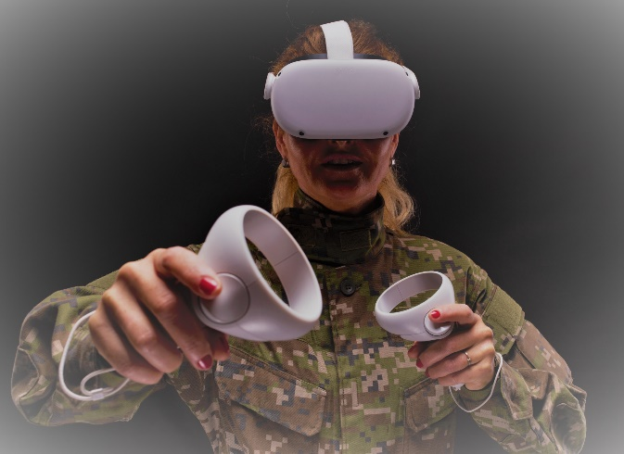
Immersive
Training
Realistic & engaging environment
Learn by doing
Improve Time Management
Conduct tasks that would take hours to prepare in real life repeatedly
Reduce the risk in training
Virtual environment is as safe as it could be.
SIGNIFICANTLY IMPROVE EOD TRAINING
More efficient training
Improving decision-making process by increasing overall time spent on conducting the tasks

Slide 4
POSSIBILITIES OF VR FOR EOD ARE LIMITLESS
Have all the tools at your disposal
Be outside - inside
Use 3D models of explosive ordnance, tools and accessories
Preparation of EOD tasks is a matter of seconds, conducting them is a matter of minutes
Accomodate parameters of the environment to your preferences and enjoy different conditions in the comfort of your home / office / classroom
Focus on what is important
Always be able to dive straight into your tasks, practicing repeatedly the EOD work, or just specific parts of it

Slide 5
NEW APPROACH TO EDUCATION & TRAINING
„A Breath of Innovation in EOD Training“
Implementing new technologies such as VR can have additional benefits:
Attracting new generation of EOD personnel
Refreshing the knowledge by using different tools and conditions
CLIK HERE

Slide 6
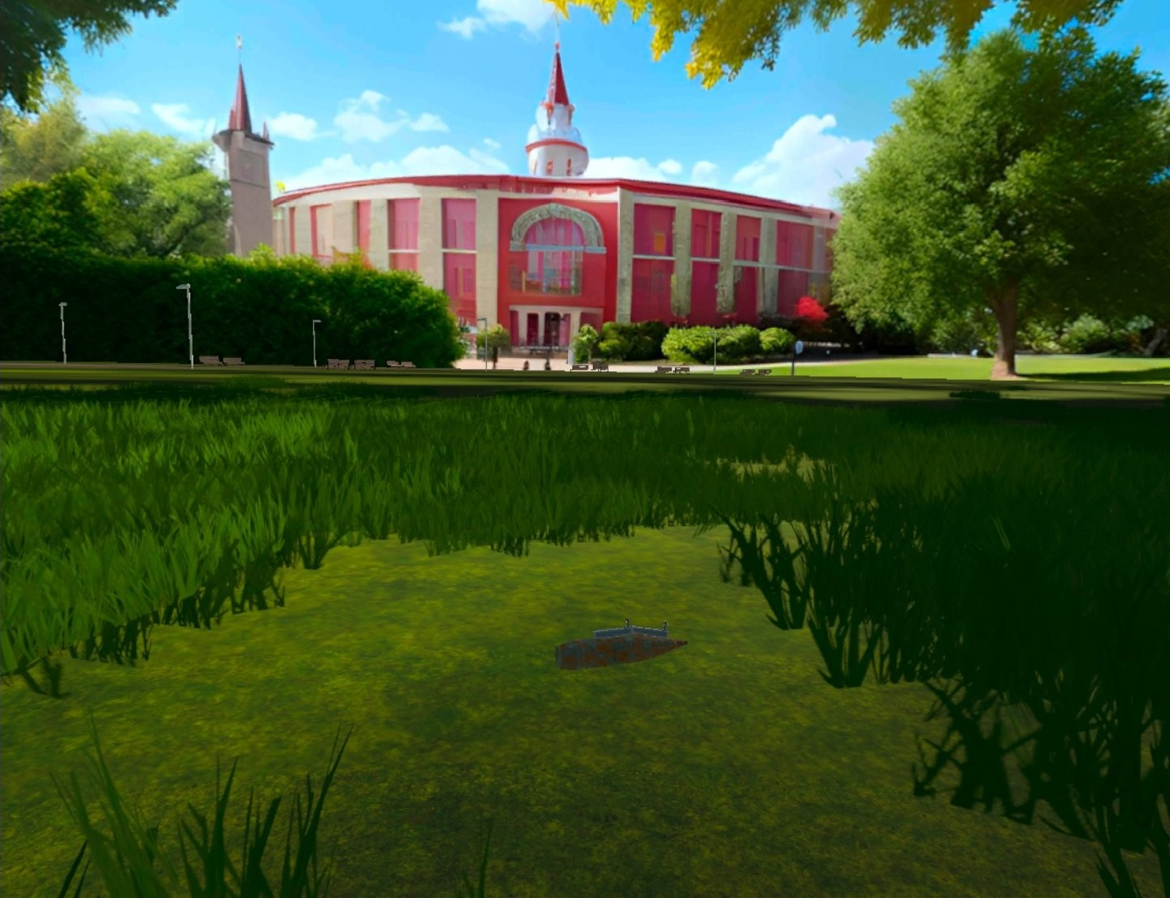
CHALLENGES OF VR EOD TRAINING
Compatibility within NATO
Each country uses their own procedures to deal with EO threat
Difference in tools, dummies
Create a tool which fits needs of all nations within NATO
„Challenge is an opportunity to rise“
Paying attention to details
Every detail matters and there are many things to keep in mind at all times
Achieve desired quality
Anything can be created, but the requirements for the quality of the product is very high

Slide 7
ETACS Project – Connection of Virtual Reality & EOD Training
EOD/IEDD VR/XR Training and Combat Support Kit
EOD/IEDD VR Training Kit

Slide 8
WHAT DOES ETACS PROJECT FOCUS ON
Instructor & Student – Constant Interaction
Decision-making process
Immediate evaluation – according to national standards
Unpredictability
Guidance for new students
An instructor will be able to evaluate the whole reasoning process of a student.
All tools are at student‘s disposal – it is up to them which they choose and how they use them.

Slide 9
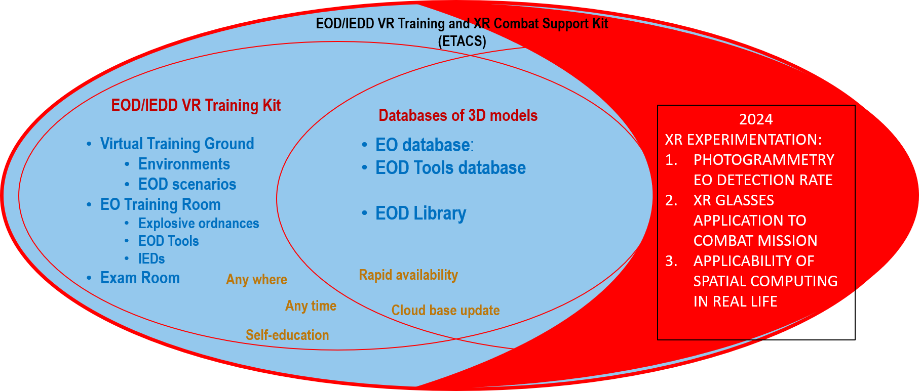
ETACS COMPOSITION
Tackling Challenges
Each part of the Training Kit targets a specific training goal.
Together they form a coherent systemic tool to support training of EOD operators
3D Models Databases
Serve as a source of all items for learning – ordnance, tools, educational resources, etc.
Notes:
XR experimentation deals with exploring options for a Combat Support Kit using different technologies together

Slide 10
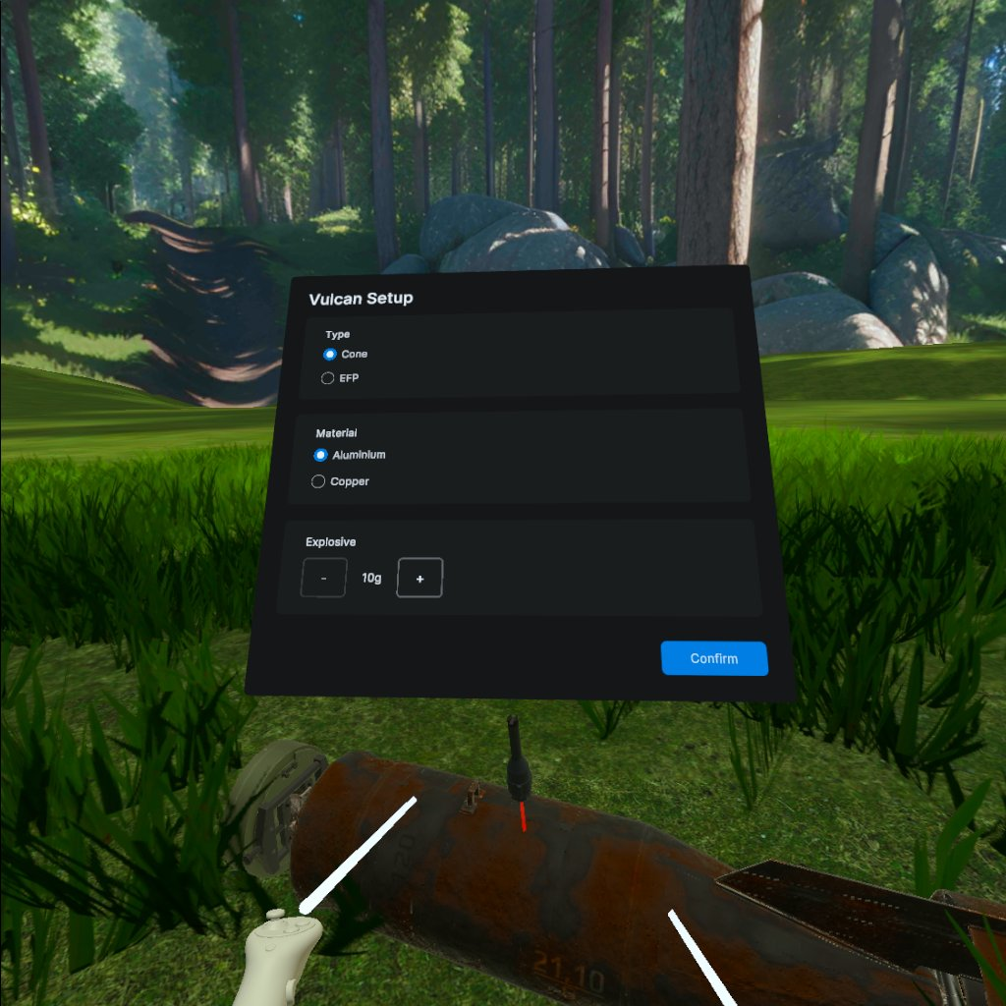
Access to bulk of information in one place
AREAS OF EOD TRAINING, THAT WILL BE IMPROVED
Identification
Constant practice
Decision-making process

Slide 11
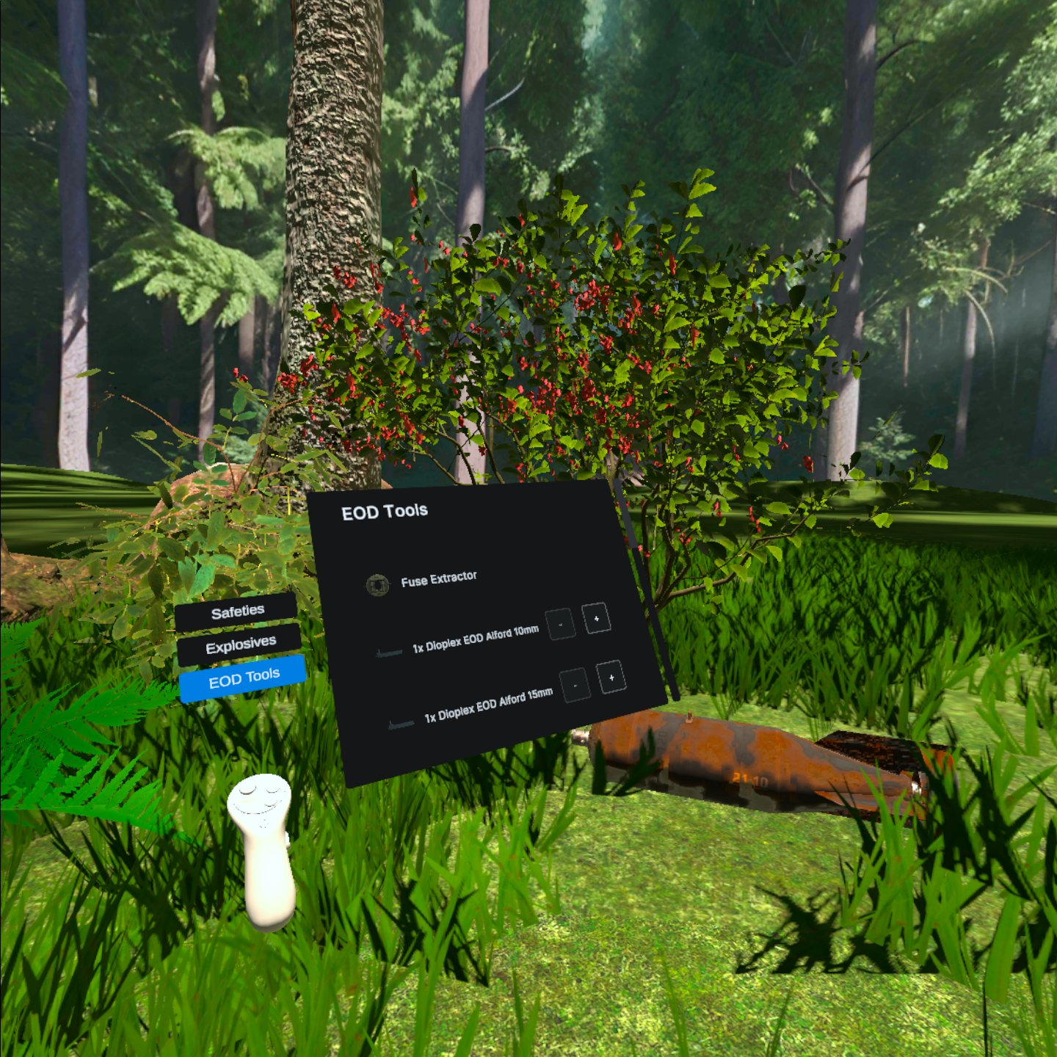
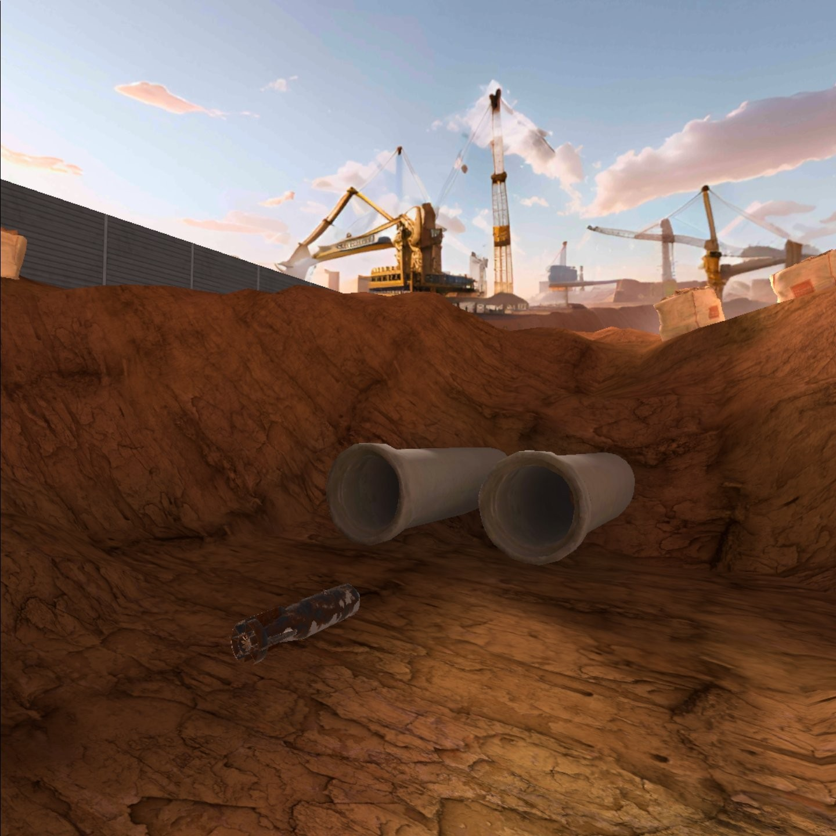

Slide 12
CONTACT
EMAIL ADDRESS
PHONE NUMBER
WEBSITE
etacs@eodcoe.org
david.slatkovsky@eodcoe.org
+421 911 679 429
+421 960 333 561
https://www.eodcoe.org/en/technology-dept/eod/iedd-vr/xr-training-combat-support-kit/

Slide 13
THANK YOU!!
IN THE FUTURE TECHNOLOGY IS DEVELOPING VERY FAST

