Slide 1
J3 EOD Experience from EUTM MALI
Lieutenant Colonel René HEČKO (OF-4)

Slide 2
AGENDA
EUTM MALI INFO
MALI EO THREAT ASSESMENT
EOD JDs
EOD EXPERTISE PROVIDED

Slide 3
Operation history
The first mandate of the EUTM Mali mission was approved by the European Council on 17 January 2013.
mandate 2013-2014
mandate 2014-2016
mandate 2016-2018
mandate 2018 – May 2020
mandate 2020 – May 2024
The mission area has expanded over the course of various mandates.
EUTM Mali supports the start of the process of disarmament, demobilization and reintegration (DDR) initiated by the peace agreement.
he Military Planning and Conduct Capability (MPCC), located in Brussels, has the strategic level responsibility for the planning and conduct of the EU’s non-executive military missions.
It acts under the political control and strategic direction of the Political and Security Committee (PSC).
At operational level, Mission Force Commander (MFCdr) –at present, the Spanish General Enrique Millan- exercises command with the support of a Mission Force HeadQuarters (MFHQ) located in Mali. In addition, a Mission Support Cell (MSC) of the MFHQ is transiently included in the MPCC in Brussels.

Slide 4
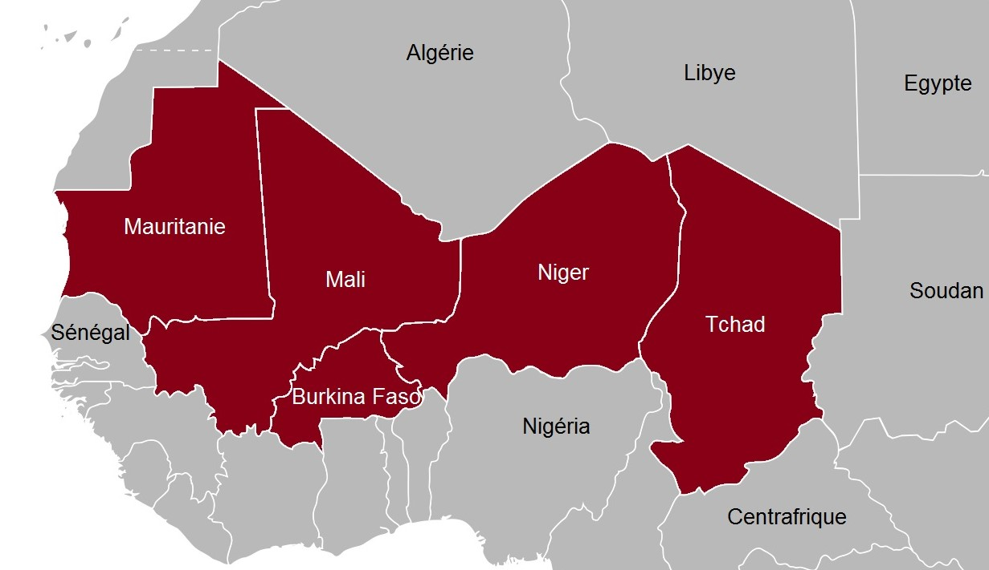

Area of Operation
4250 km
1850 km
Number of Countries: 5 (MAU – MLI – NER – BKF – CHA)
Area: 7,8 mil. km² (4 846 695.29945 miles²)

Slide 5






















Organization of the operation
MPCC
Bléjean
16 NATIONS
BRUSSELS Mission Support Cell
Strategic
Operational
ORTIZ-REPISO
MPCC – Military Planning and Conduct Capability
HQ
HQ
Tactical
Education, Advisory and Training Task Force
Force Protection & Combat Service Support
Mission Security Team
Medical Capabilities
(MED CAP)
MED CAP
26 + 27
National Support Elements
Enable / Support
Contractors

Slide 6
TIMELINE
05APR22
PSC agreed to suspend temporary and reversibly the operational training activities
13JUL22
FRAGO from MPCC
-revision of the MPLAN
-reduction of the Mission’s overrall footprint (apx.300 pax)
-suspend all infrastructure investments
16SEP22
Approval of a new MPLAN
21NOV22
Approval of a new MORDER
22DEC22
Issue 3-MORDER
01JAN-31MAR23
PSC– Political and Security Committee
EU LIMITE

Slide 7

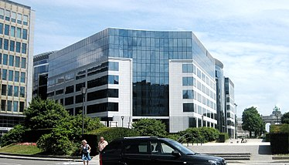

MISSION PLAN
MISSION
EUTM Mali will focus the activities on support to:
MaAF, on strategic advice and education only. All operational and non-operational training activities are temporary and reversibly suspended;
BFA, NER, G5S JF and (other) G5S armed forces in order to support its/their operationalization.
MAIN EFFORT
Maintaining liaison with MaAF, supporting the MaAF reforms as applicable and (re)building mutual trust and confidence with MaAF.
EU LIMITE

Slide 8
Organization of the operation
Purpose
Mandate 5 (May 2020 – May 2024)
MPLAN rev. 1 (16. September 2022)
MORDER 21NOV22
EUTM Mali focuses on supporting the Malian Armed Forces, exclusively in the form of strategic advice and training support. Training activities are temporarily suspended, but EUTM Mali is ready to resume them immediately after a change in conditions. EUTM Mali also provides military assistance with its forces and resources to BURKINA FASO and NIGER, as well as to the G5 Sahel Joint Force and the armed forces of individual G5 Sahel members in order to increase their operational readiness.
Advisory
Strategic level
Implementation
„Loi d´Orientation et Programmation Militaire“
Education
Officers and NCOs of the Malian Armed Forces are trained according to international standards
Training
Temporarily suspended
G5 Sahel
Building / Forming the security sector of BURKINA FASO and NIGER
Support
Improvement of STRATCOM

Slide 9
MISSION PLAN
LINE OF OPERATIONS
MILITARY STRATEGIC OBJECTIVES
STRATEGIC OBJECTIVES
MSO1
Malian Military Strategic Level able to implement the Loi d’Orientation et Programmation Militaire in all relevant structural domains.
Contribute to improve the operational capacity of MaAF under the control of Mali’s legitimate civilian authorities
LoO1 ADVISING MaAF
(Orientation Law and Military Programming)
MSO2
Future MaAF Officers and NCO professional skills developed under international standards.
LoO2 EDUCATION MaAF
MSO3
When conditions are met and so decided on by PSC, to resume operational and non-operational training.
LoO3 TRAINING MaAF
Support the G5S through the operationalization of the G5S JF and of the national armed forces in the G5S countries
MSO4
The G5SJF and G5S national AF have improved operational capabilities and, in particular BFA and NER is supported
LoO4 G5S
MSO5
The EU STRACOM is improved IOT fight information manipulation in a proactive manner and to improve perception on EUTM.
LoO5 SUPPORT

Slide 10
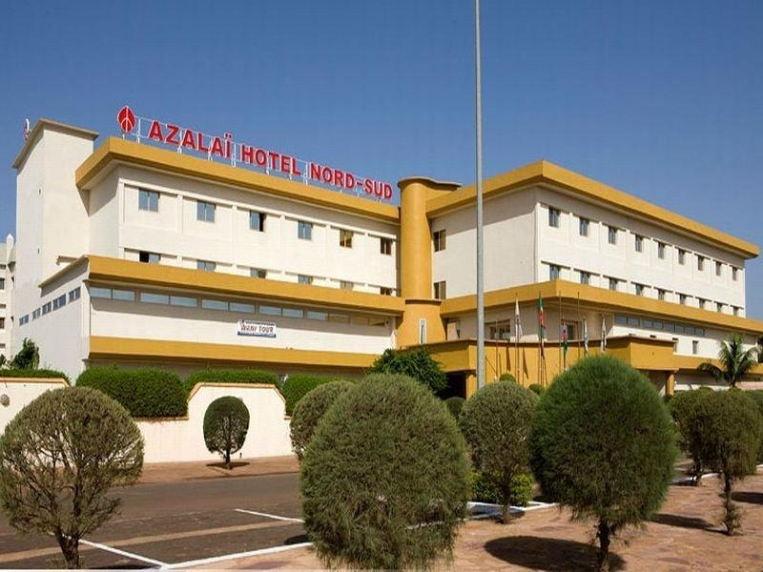

MISSION ORDER
MISSION
MFCdr will conduct millitary asssistance to:
MaAF, focussed on Strategic Advice and Education and develop plans to resume training;
BFA Armed Forces;
G5S JF.
MAIN EFFORT
The main effort will be to mantain liaison with MaAF by rebuilding mutual confidence.
EU LIMITE

Slide 11
Source Documents
The EUTM Mali mandate is authorized by the relevant decision of the Council European External Action Service (EEAS) Common Foreign and Security Policy (CFSP) from 2020.
5 EUTM mandate of 24 April 2020 EUTM Mali Mandate 5 Mission Plan European External Action Service (EEAS) 2020/451 of 28/04/2020
The mandate of 24. April 2020 amends Council Decision (CFSP) 2018/716 of 14. May 2018 and Council Decision 2013/34 / (CFSP) of 17. January 2013 on the European Union Military Mission (EUTM Mali) " in follow-up to the letter of invitation sent to the EU by the Republic of Mali on 24. December 2012.
he Military Planning and Conduct Capability (MPCC), located in Brussels, has the strategic level responsibility for the planning and conduct of the EU’s non-executive military missions.
It acts under the political control and strategic direction of the Political and Security Committee (PSC).
At operational level, Mission Force Commander (MFCdr) –at present, the Spanish General Enrique Millan- exercises command with the support of a Mission Force HeadQuarters (MFHQ) located in Mali. In addition, a Mission Support Cell (MSC) of the MFHQ is transiently included in the MPCC in Brussels.

Slide 12
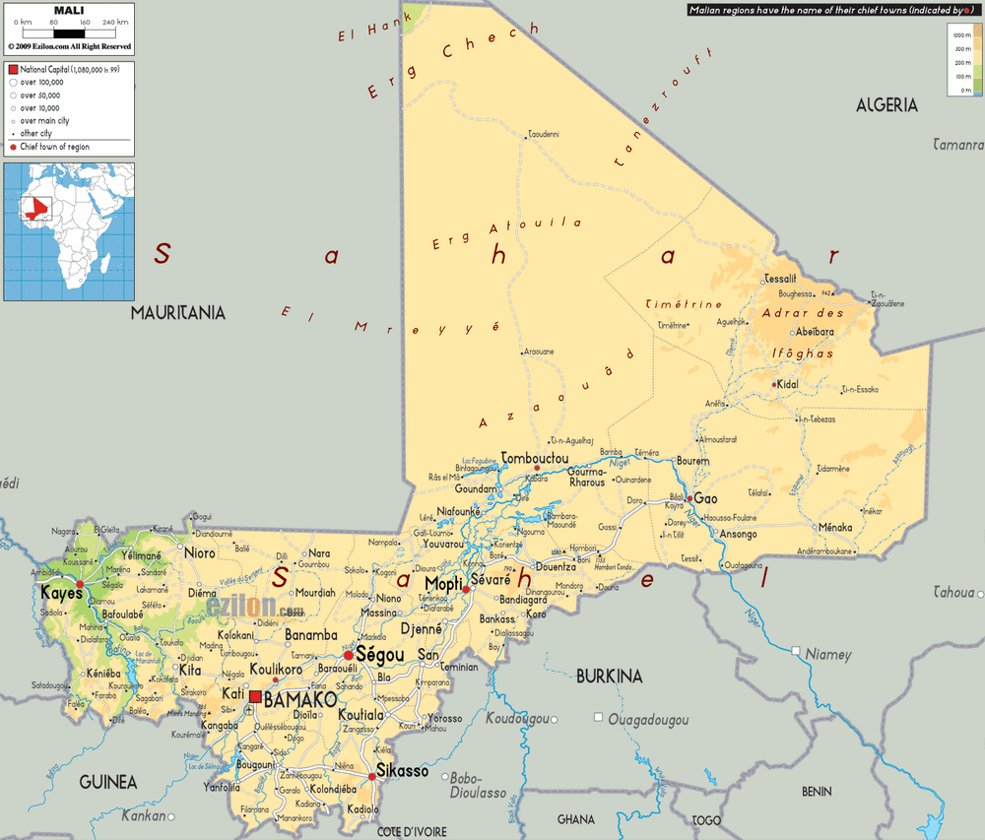
„Current“ security situation
MALI
The facts | République du Mali Republic of Mali
The heads of state and government | Interim president: COL. ASSIMI GOITA Interim prime minister: CHOGUEL MAÏGA
Capital city | Bamako
Population | (2021 estimated) 21,120,000 (2030 estimated) 28,020,000
Official languages | French Bambara
Area (km²) | 1, 240,192
currency | West African franc (CFA)
Urban and rural population | Cities: (2018) 42.4% Countryside: (2018) 57.6%
life expectancy | Men: (2017) 65.7 years Women: (2017) 68.2 years
Literacy | Percentage of literate population aged 15 and over: Men: (2015) = 45.1% Women: (2015) = 22.2%

Slide 13
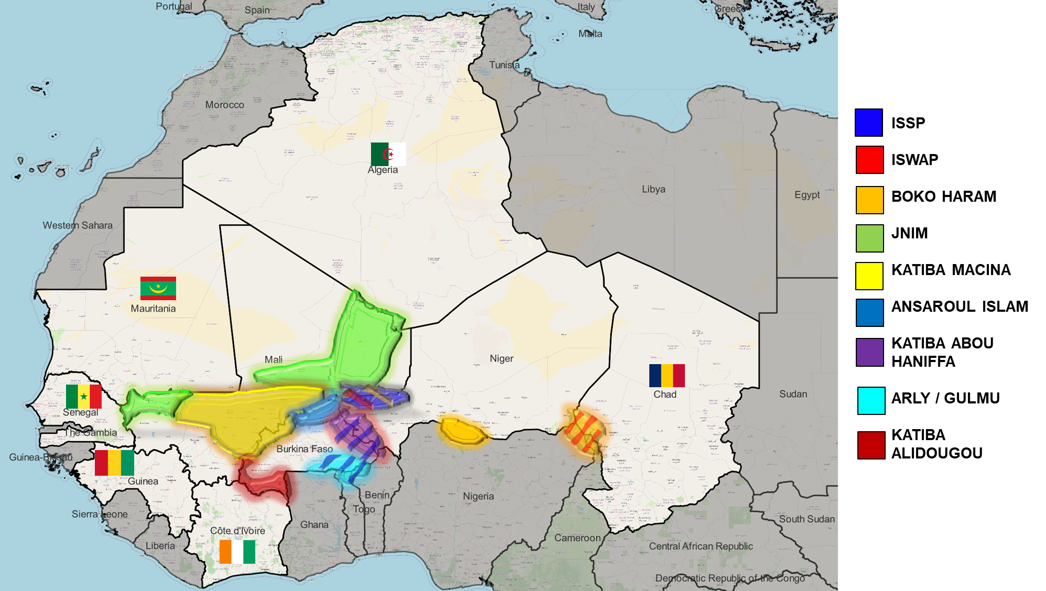
„Current“ security situation
Terrorist groups in the G5 Sahel

Slide 14
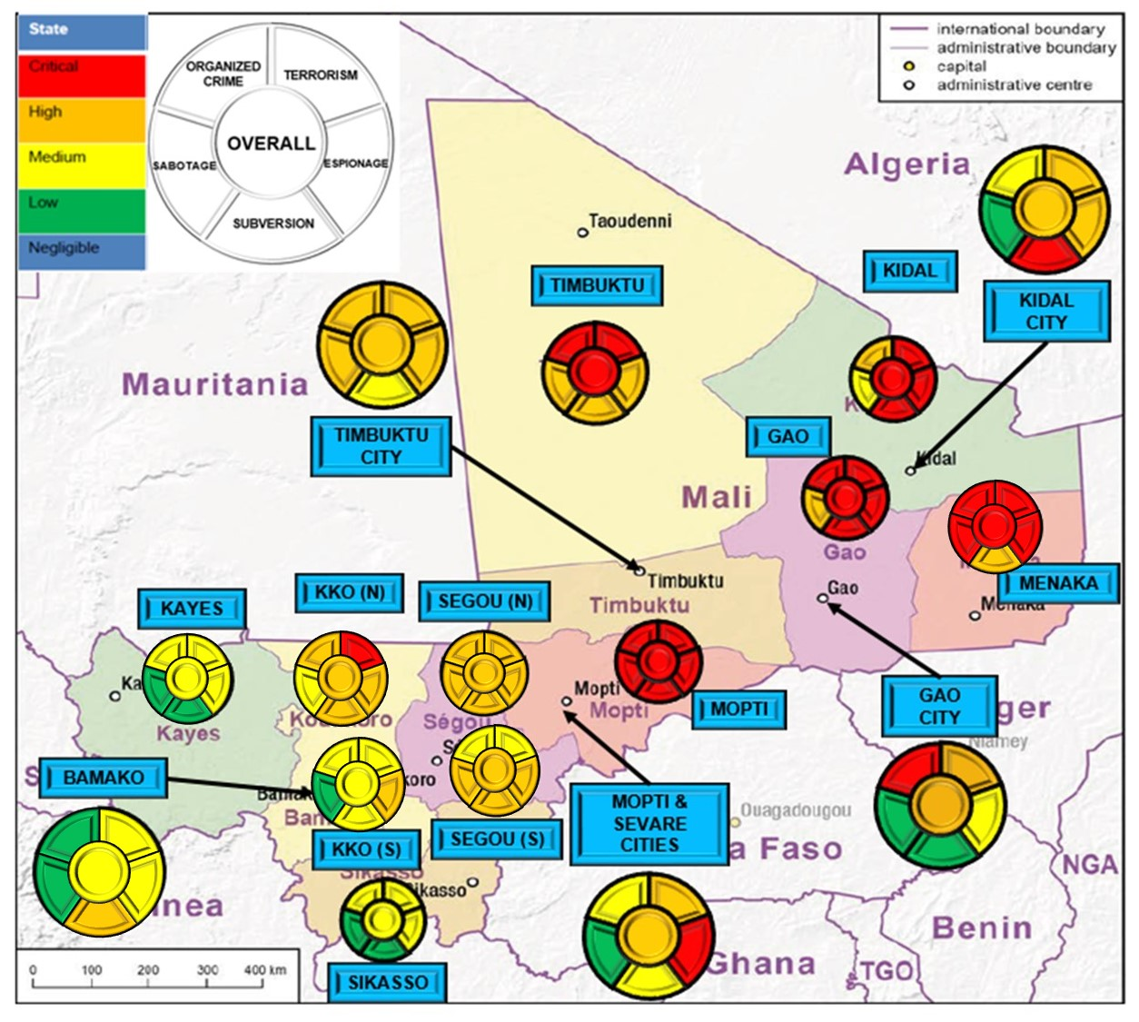
„Current“ security situation
MALI

Slide 15
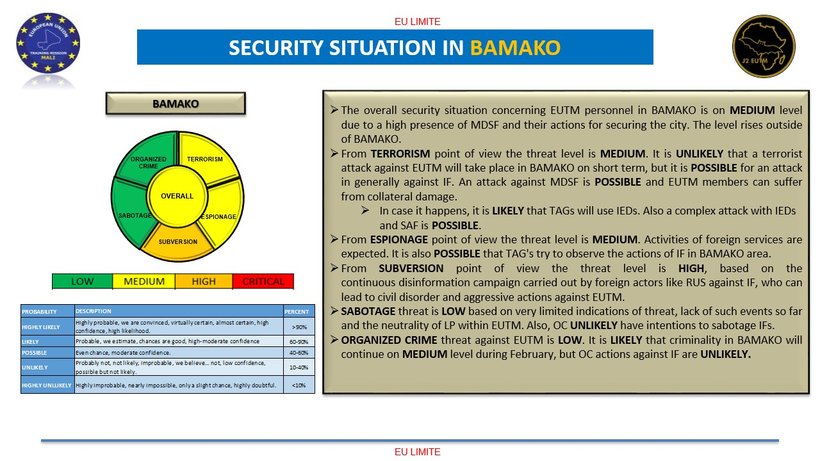
„Current“ security situation in BAMAKO
MALI 28FEB23

Slide 16
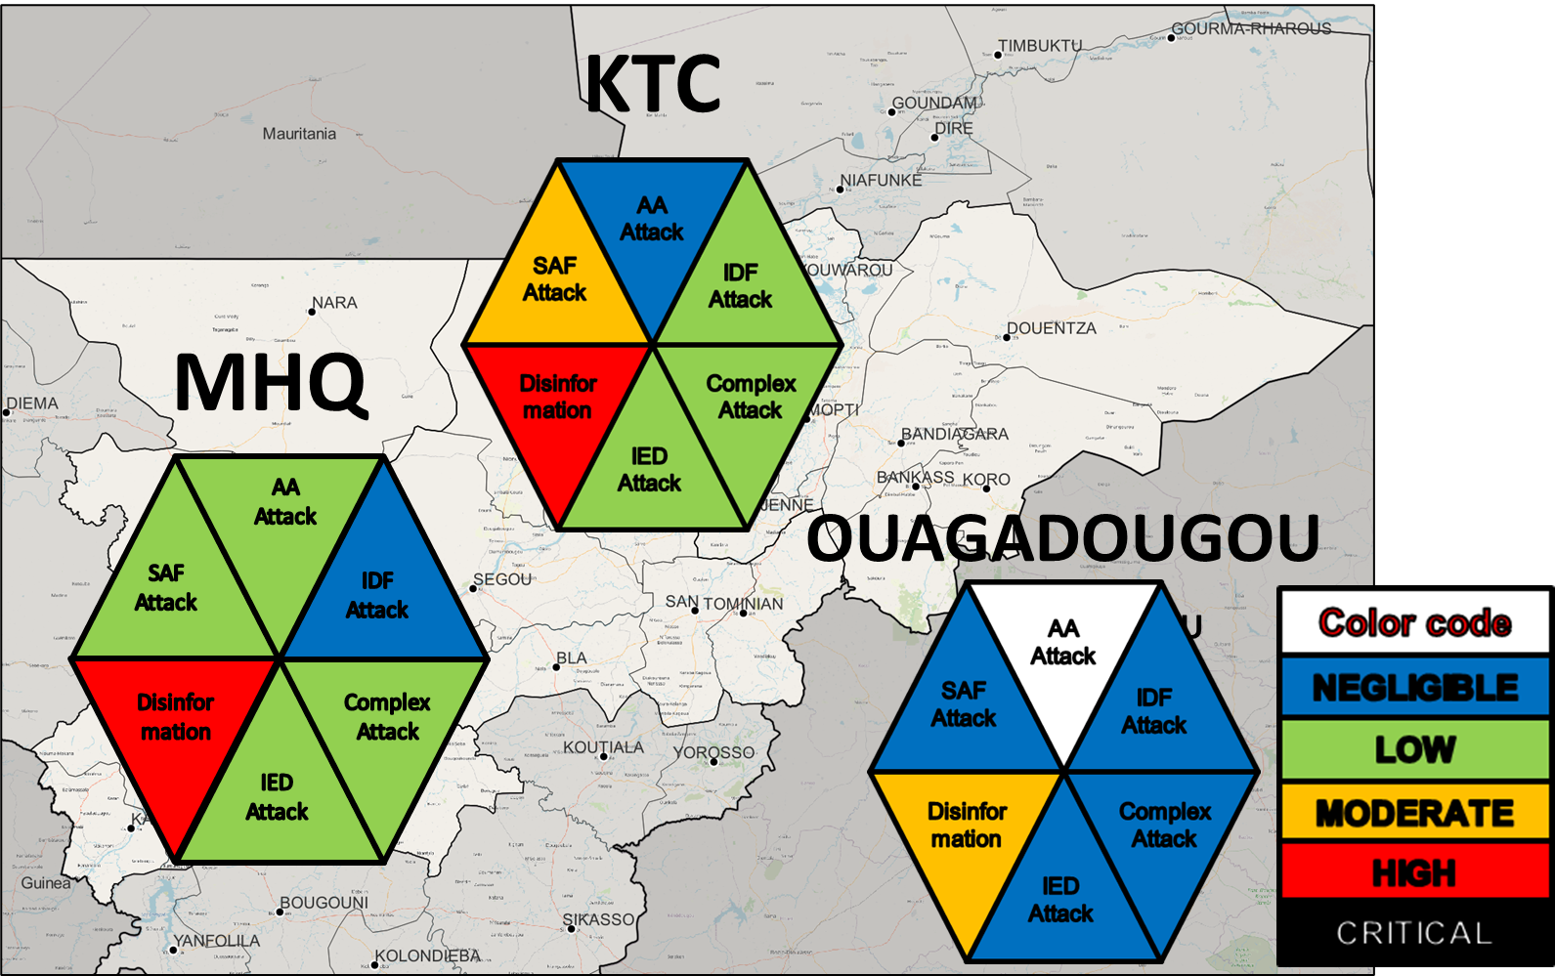
„Current“ security situation
Threat of forces 28FEB23

Slide 17
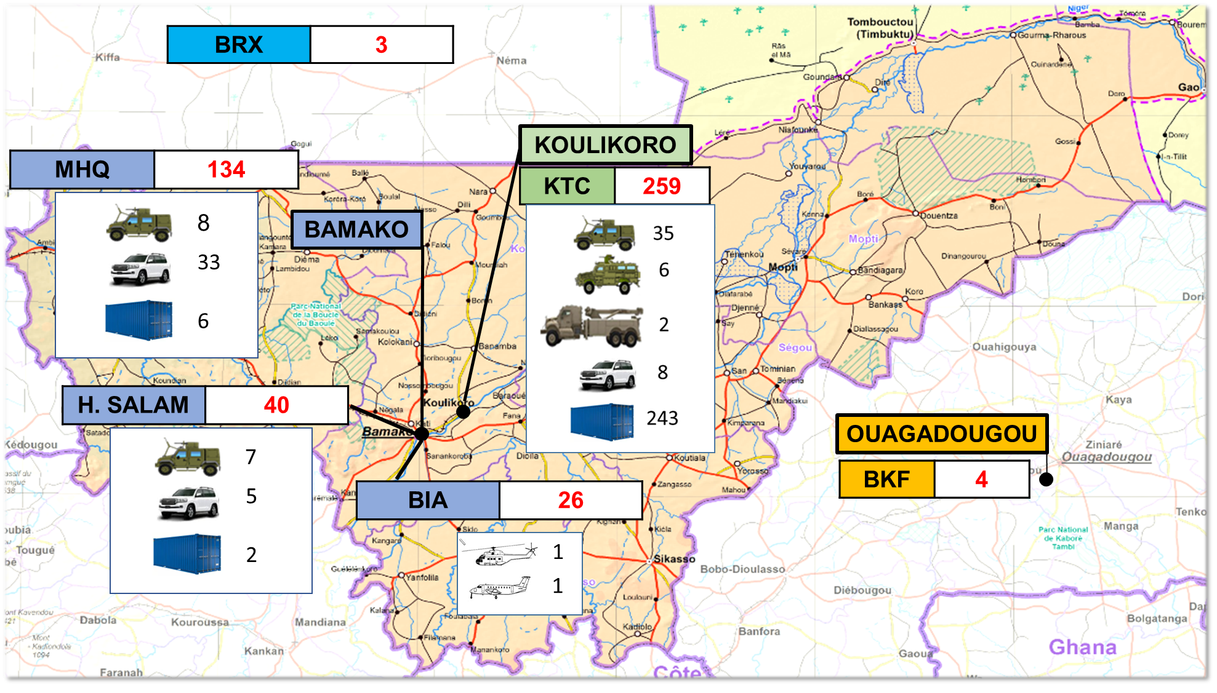
EUTM forces layout
dated 15JAN23
TOTAL STRENGTH
466
BIA: BAMAKO International Airport.
BRX: BRUSSELS.
BKF: BURKINA FASO.
KTC: KULIKORO Training Camp.
MHQ: Main Headquarter (Hotel Nord SUD).
H.SALAM: Hotel Salam.

Slide 18

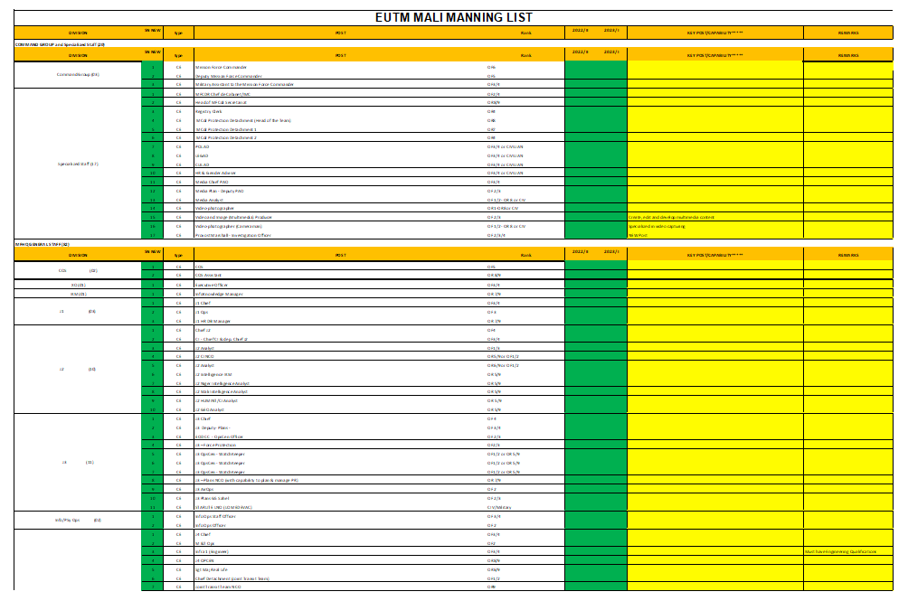
Organizational structure
Strength
2022
MAR23
MAY23
JUL23
25APR23
19th GFGC**
NEW CEL
NEW CEL v2
Transitional period
old CEL*
1059 in sum
414 in sum / 345 occupied
298 positions / 211 (71%)
53 Contractors (CIV)
63 on call
100 in sum
2022
Phase 1 Adjustment
Phase 2 Consolidation
Phase X Reduction
TRANSITION
REDUCTION
* CEL: Crisis Establishment List.
** GFGC: Global Force Generation Conference.

Slide 19
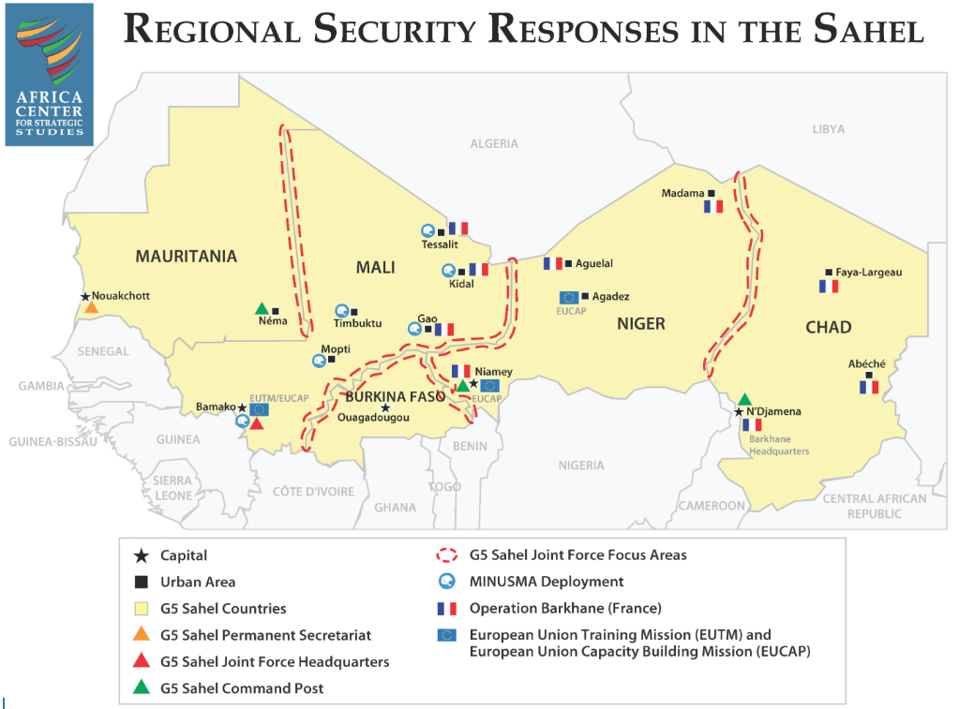
Operational deployment within G5 Sahel

Slide 20
Main Tasks of SLOVCON in EUTM Mali
Deputy Chief of J3 / J3 Plans / EOD CC
Chief of INFO OPS
J2 Analyst
Watch - keeper
Watch - keeper
Deputy Chief J3
Coordination, planning and management of EUTM Mali operations
Management of the operational planning group
Member of the MIRT (major incident response team)
Member of the Mission security board and MSWG
Coordination of EOD support to EUTM Mali
Analysis and assessment of EO threats in the G5 Sahel
Coordination of EOD and C-IED efforts of EUTM Mali
Creation and revision of SOP
Responsibility for the ammunition depots in EUTM Mali
Head of working groups with MINUSMA and UNMAS
Fulfillment of SNR tasks

Slide 21
AGENDA
EUTM MALI INFO
MALI EO THREAT ASSESMENT
EOD JDs
EOD EXPERTISE PROVIDED

Slide 22
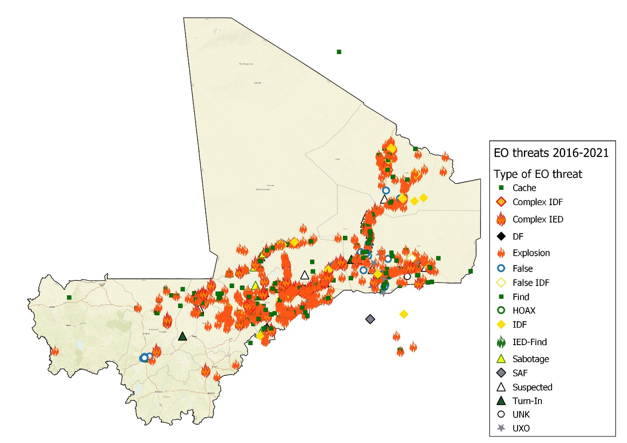
EO Threats in Mali 2016-2021

Slide 23
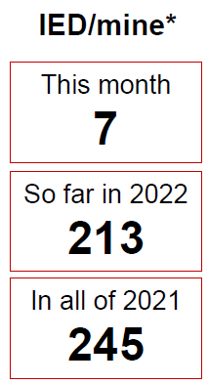
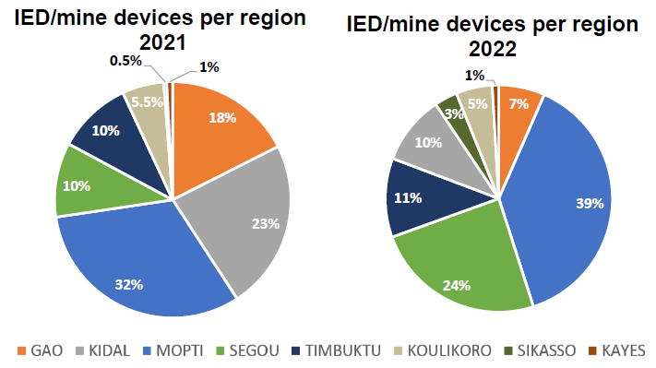
ANALYSIS OF EO THREATS IN MALI
DEC22
14
DEC22
14
Updated 31DEC22

Slide 24
ANALYSIS OF EO THREATS IN MALI
Updated 31DEC22

Slide 25
EO INCIDENTS IN MALI REGIONS
Updated 31DEC22

Slide 26
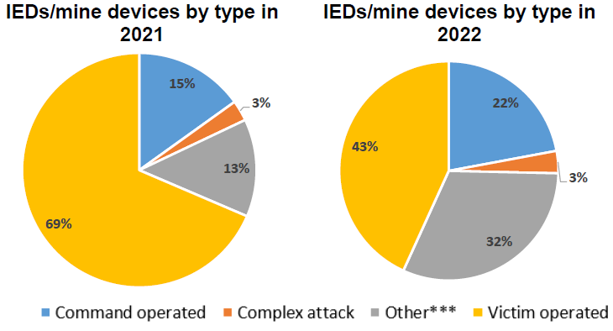
IEDs PER CATEGORY PER YEAR
Updated 31th December 2022 (source dated 31th December 2022)
In order, VOIED, RCIED & ERW/Mine were the 3 most commonly encountered Explosive Hazards in Mali in 2022.
VOIEDs have continued to be the main threat in 2022.
OTHER: It is assessed that tasks falling into OTHER (incl. ERWs/Mines and Caches) are approximately 70 % VOIEDs and 30 % Command IEDs, however this cannot be confirmed due to the lack of Post Blast Investigation (PBI) at many scenes.

Slide 27
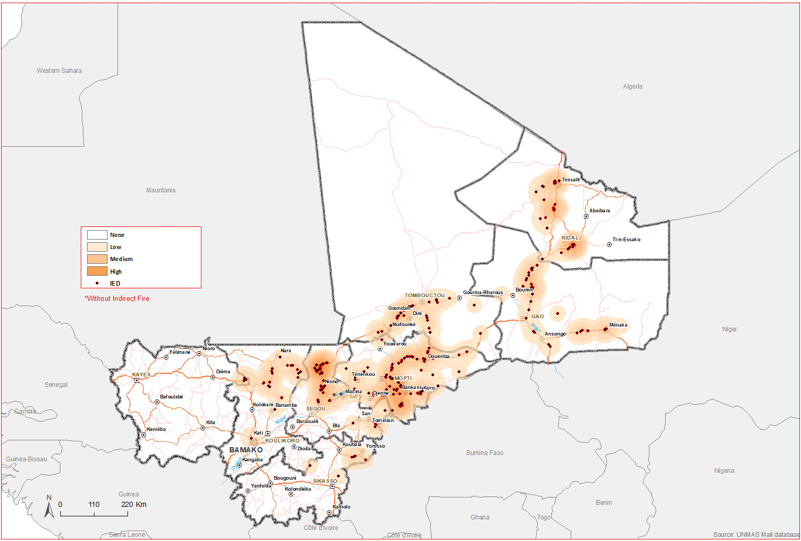
IEDs in Mali 2022 - 2023
Updated 11FEB23

Slide 28
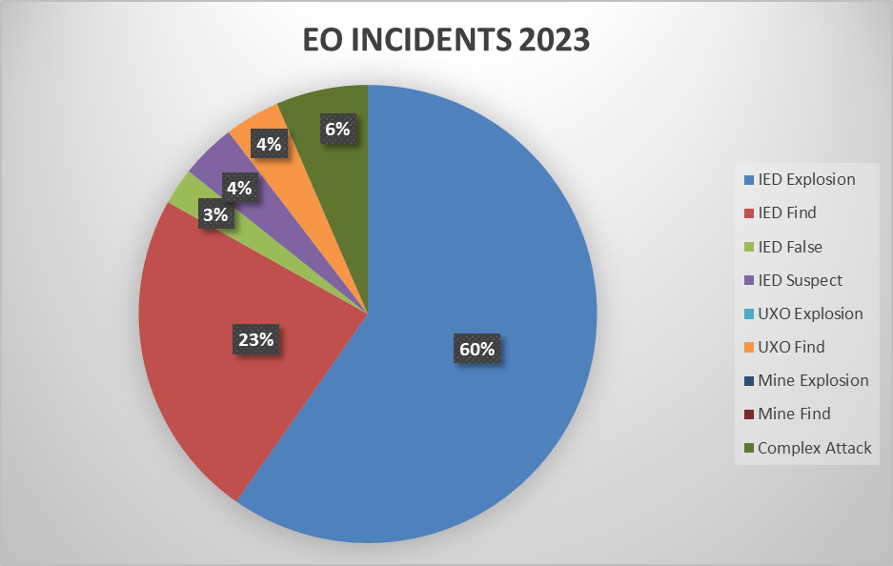
ANALYSIS OF EO THREATS IN MALI
So far 2023
77
2022
227
2021
245
APR23
7
Updated 16APR23

Slide 29
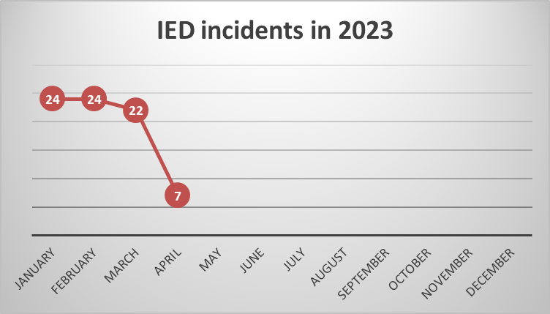
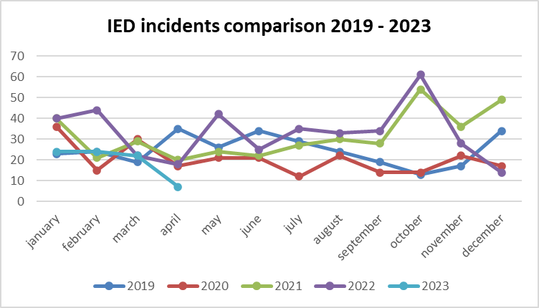
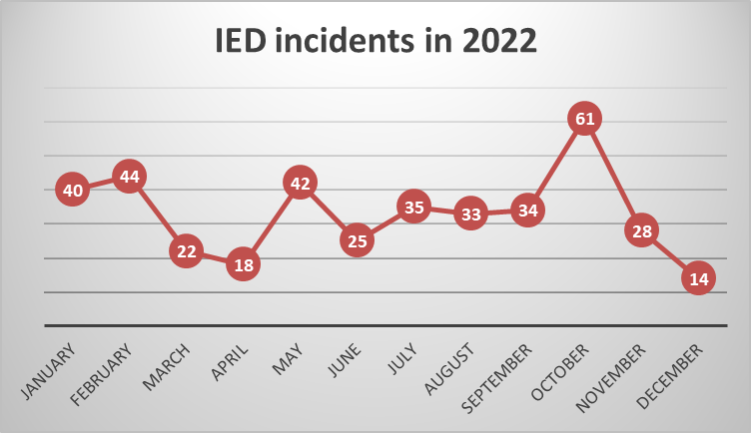
ANALYSIS OF EO THREATS IN MALI
Updated 16APR23

Slide 30
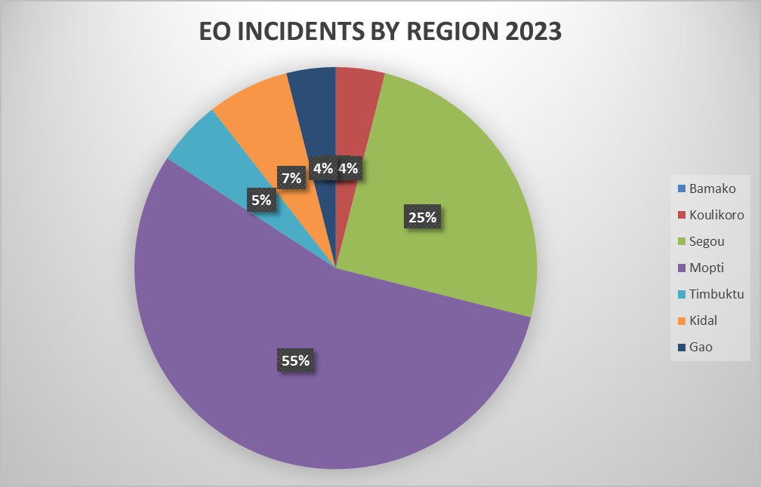
EO INCIDENTS IN MALI REGIONS
Updated 16APR23

Slide 31
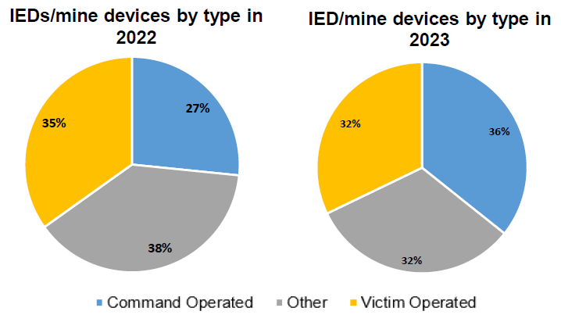
IEDs PER CATEGORY PER YEAR
Updated 16APR23 (source dated 31MAR23)
In order - COIED, VOIED & ERW(Mines) are the 3 most commonly encountered Explosive Hazards in Mali in 2023.
VOIEDs are possesing significant threat in 2023 – but shift to COIEDs is visible.
OTHER: It is assessed that tasks falling into OTHER (incl. ERWs/Mines and Caches) are approximately 70 % VOIEDs and 30 % COIEDs, however this cannot be confirmed due to the lack of Post Blast Investigation (PBI) at many scenes.

Slide 32
General assessments
HIGHLY LIKELY:
MSRs will remain the most targeted entities, especially in the known threat boxes.
The VOIED will remain the most used IED type.
TAGs are improving their IDF accuracy and coordination of IDF attacks to support CxATKs which incl. IEDs.
LIKELY:
CxATKs, SVBIED and POSSIBLY PBIED attacks will be used towards MDSF and IF, especially in retaliation for ongoing and past operations.
TAGs place secondary IEDs.
TAGs has the capability to execute accurate and coordinated IDF attack.
TRENDS:
The use of conventional anti-personnel and anti-tank (anti-vehicle) mines.
RCIED emplacement in hard-topped roads.
Placing of RCIEDs in wrecked cars to initiate a CxATK.
Use of multiple IEDs.
Increasing weight of homemade explosive main charge (HME MC) – ANFO/ANS.
Use of Unmanned Aircraft Systems (UAS).

Slide 33
C-IED RECOMMENDATIONS
According to the reported data, the most dangerous area in our MA (Mission Area) is the MOPTI region with 39 % in 2022 and 55 % so far in 2023 of all EO incidents within the MALI – these data are only from one source (MINUSMA) and are delayed.
It is unlikely that the EO threat will be directly on the MSR ELPHANT and DOLPHIN, but it is possible on the side roads - minimizing the use of side roads, or search for IED indicators or suspicious LP behaviors.
The typical weight of HME in a MC of the convoy targeted IED is approximately 10-30 kg - for mitigation, MRAP vehicles are to be primarily used.
The most used type of IEDs is the VOIED (Victim-Operated Improvised Explosive Device), followed by the RCIED (Radio-Controlled Improvised Explosive Device) – ECM/CREW systems and assets are to be used.
By placing the receiver of the RCIED at a greater distance from the location of the, likely TAGs are trying to avoid interference from the ECM - detached RC wires reported in Mali are typically 8-10m long, but 70m long have also been detected - Use DOMINANCE TEAM to seize the trigger point if RCIED indicators are detected.
AT mines was used for IED MC – treat AT mines initially as IED.
Use of Unmanned Aircraft Systems (UAS) - treat UAS initially as IED.

Slide 34
AGENDA
EUTM MALI INFO
MALI EO THREAT ASSESMENT
EOD JDs
EOD EXPERTISE PROVIDED

Slide 35
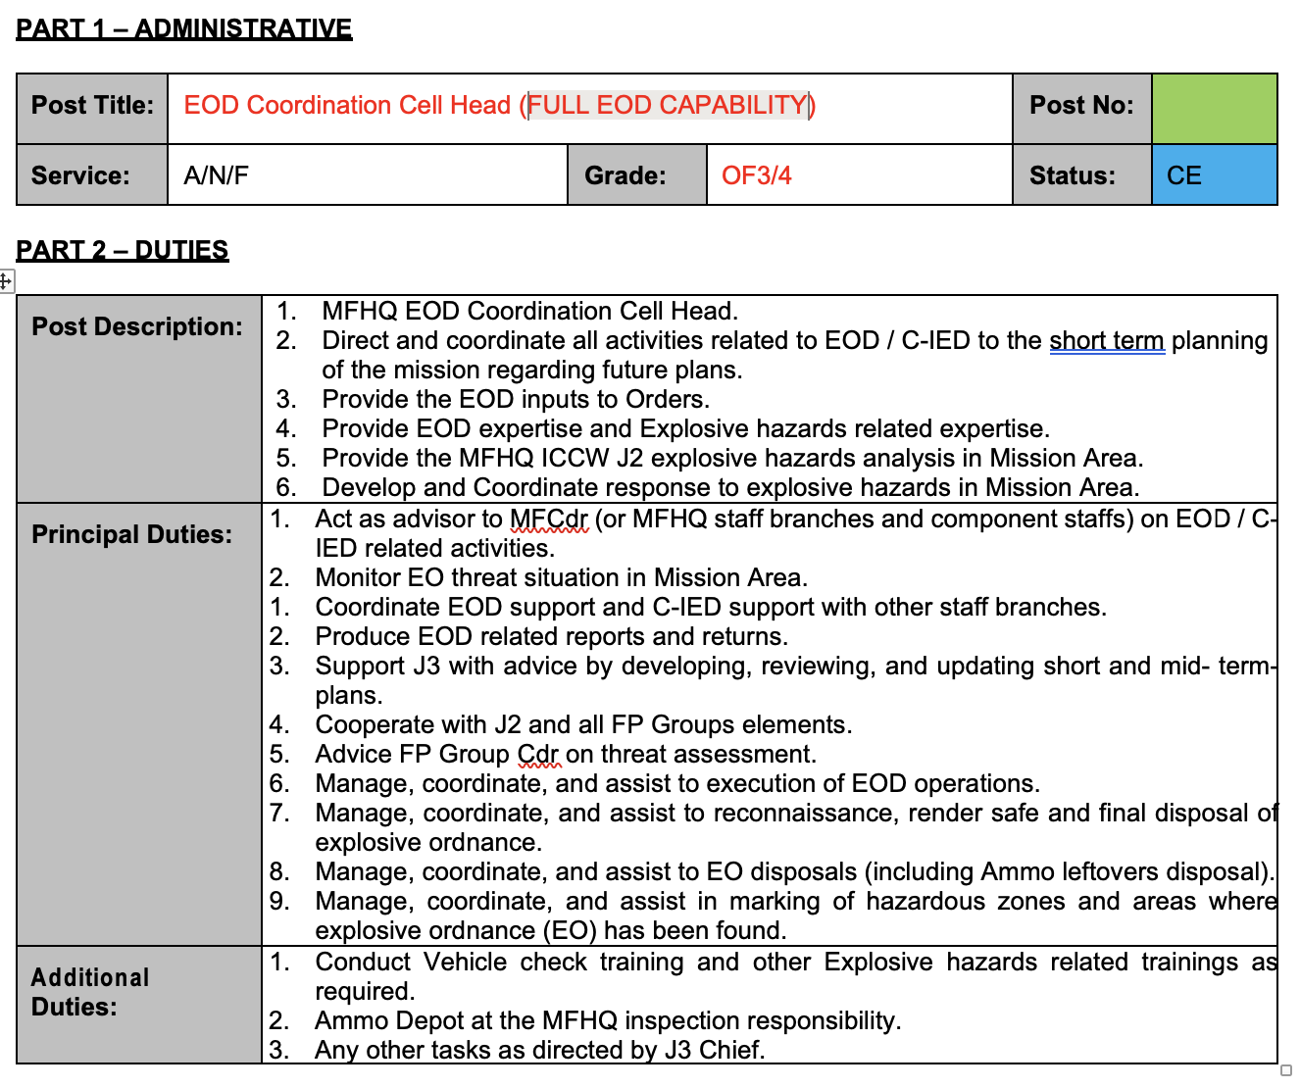
EOD JDs

Slide 36
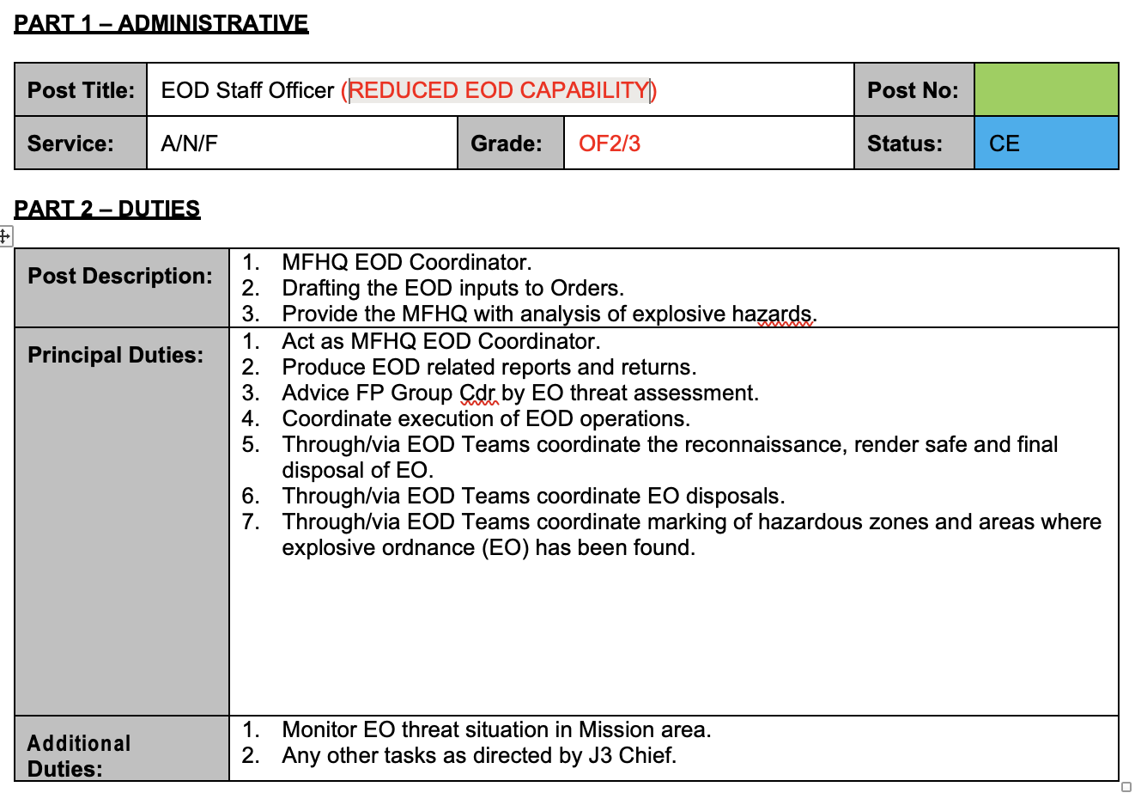
EOD JDs

Slide 37
AGENDA
EUTM MALI INFO
MALI EO THREAT ASSESMENT
EOD JDs
EOD EXPERTISE PROVIDED

Slide 38
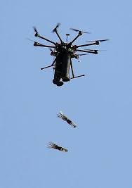
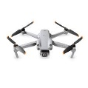
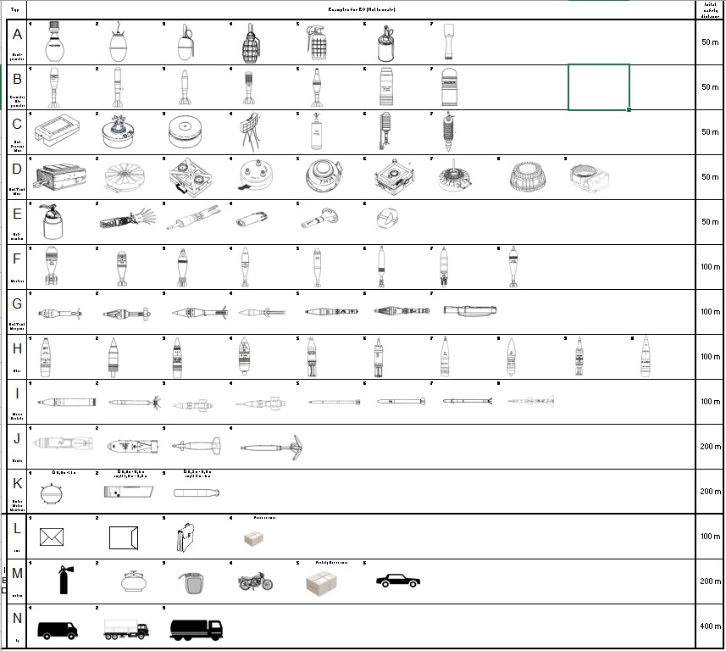
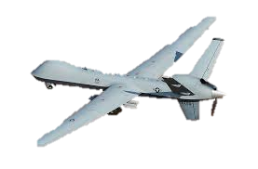

EOD EXPERTISE
UAS / EOD ASSESSMENT
If UAS landed / grounded / crashed = EXPLOSIVE HAZARD (EH)
ACTIONS IAW C-IED procedures
C-IED 5Cs´ FIRST RESPONDER and EOD as RESPONDER = INCREASED TIME
CONCLUSION: If TREATED as EH(IED) = ENHANCED FORCE PROTECTION but depends on GROUND INHIBITION ASSETS availability and technical parameters.
WORLD LIKELY / HIGHLY LIKELY
TYPE
POSSIBLE PAYLOAD
HAZARD
SAFETY DISTANCE
BLAST
FRAGMENTATION
HIGH TEMP and TOXIC
(Li-Ion/Li-Pol baterry pack)
Minimal: 50 m
Recommended: 100 m
MALI POSSIBLY
BLAST
FRAGMENTATION
INCENDIARY
(Fuel)
Minimal: 100 m
Recommended: 200 m

Slide 39
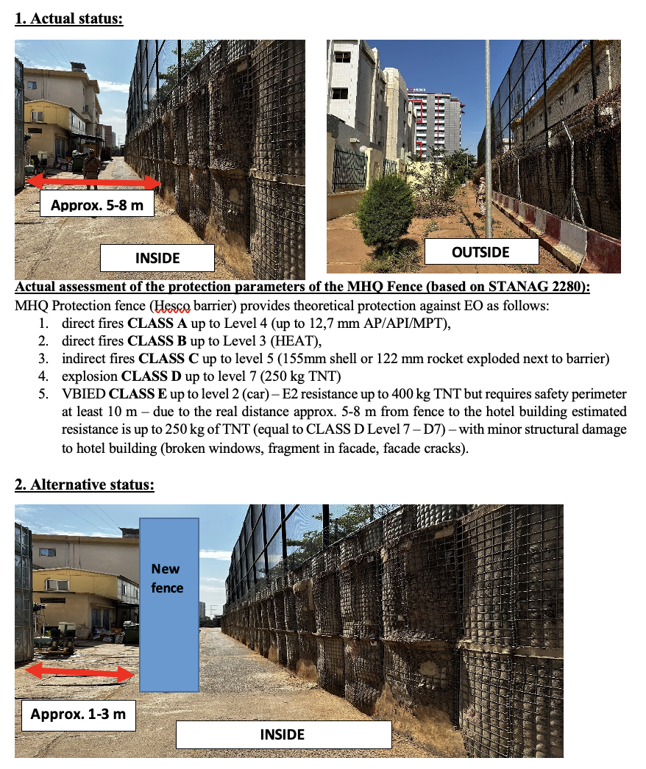
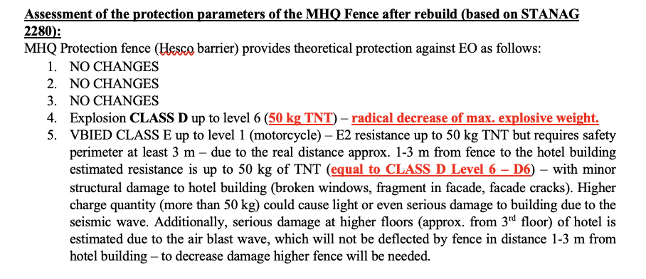
EOD EXPERTISE
HESCO BARRIER REMOVAL

Slide 40
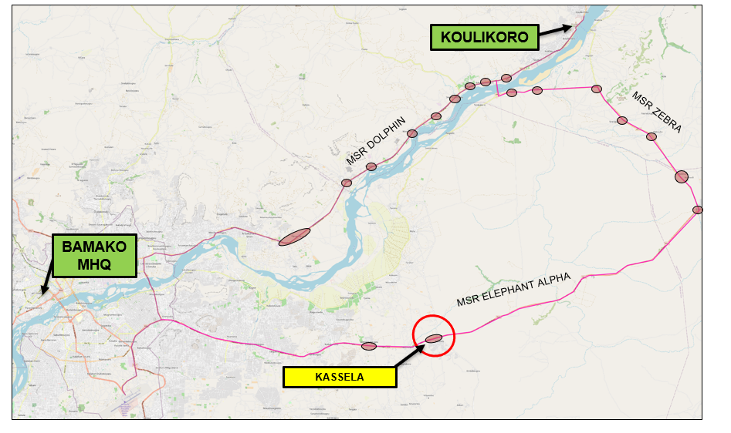
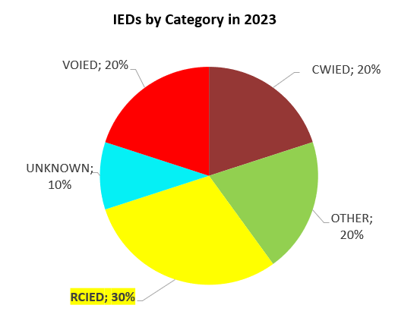
EOD EXPERTISE
IED/COMPLEX ATTACK RISK
Small towns are forced crossing points-probability of suffering a reduction in speed is higher and increases the risk of suffering a complex attack.
It is assessed as POSSIBLE that a complex attack would be carried out by VBIED activated by radio control system at the entrances and exits of the localities, adding SAF.
The placing of (RC)IEDs in wrecked cars to initiate a Cx ATK is habitual TTP of KM. Recommended not to pass a wrecked car without a proper VP check
The placing of RCIEDs in paved roads is POSSIBLE because the use of this TTP against IF in FEB23.
The VOIED remains the most used IED type in MALI as these are the cheapest to produce and the easiest to emplace.
However, VOIEDs do not discriminate between security forces and LP. Because of that it is UNLIKELY the use of this type against EUTM going out from the city.

Slide 41
EOD EXPERTISE
EOD RECOMMENDATIONS
SUMMARY from 01MAR16 to 10APR23:
approx. 2088 EO incidents in MALI with confirmed RCIED incidents rate 4,4% (overall in country).
52 EO incidents in KOULIKORO (incl. BAMAKO) – 2 confirmed incidents with RCIED (approx. + 6 extra from category OTHER/UNKNOWN) – 7 years probability of RCIED = 15% (KKO).
NO know neither confirmed EO incidents on MSR DOLPHIN & MSR ELEPHANT between BKO and KTC (Koulikoro city).
CONCLUSIONS:
It is unlikely that the EO threat will be located directly on the MSR ELPHANT and/or MSR DOLPHIN, but their use is possible on the side roads - minimizing the use of side roads, or search for IED indicators or suspicious LP behaviors.
The typical weight of main charge is approximately 10-30 kg (HME) - for mitigation MRAP vehicles are recommended to be used on side roads.
Overally, The most used type of IEDs in MALI is the VOIED (Victim-Operated Improvised Explosive Device), followed by the COIED incl. RCIED – ECM/CREW systems (jammers) are to be used on side roads.
If ECM/CREW systems are not available - Use DOMINANCE TEAM to seize the trigger point if RCIED indicators are detected.

Slide 42
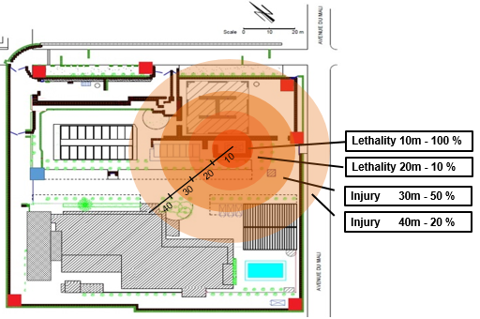
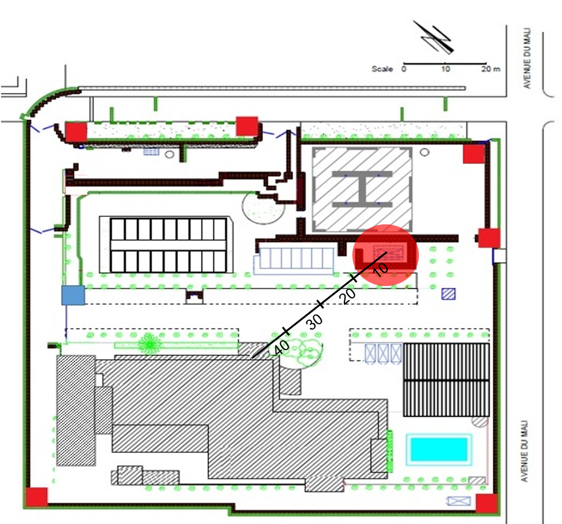
EOD EXPERTISE
MFHQ AMMO DEPOT NEQ Reduction
RECENT STATUS
NEQ 500 kg
NEQ OCCUPANCY STATUS
27FEB23
RECOMMENDED STATUS
NEQ 250 kg
RECOMMENDED NEQ 250 kg
10 m separation recommended for constructions
SOP 03-600 MFHQ AMMO DEPOT UPDATED (Active 01MAR23) – NEQ REDUCED TO 250 kg

Slide 43

Thank you for your attention.

