Slide 1
YOLO – deep learning model for UXO detection in thermal video
Milan Bajić Jr.
Department of IT and Computer Sciences, Zagreb University of Applied Sciences, Zagreb, Croatia

Slide 2
Overview
From 1991 – AI - HV/HCR/HCR CTRO
Introduction
Evaluation Dataset UXOTi_NPA
YOLO Architectures
Results
Discussion and conclusions
YOLO – deep learning model for UXO detection in thermal video
Milan Bajić Jr.

Slide 3
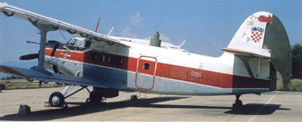
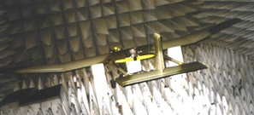
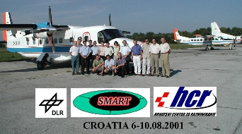
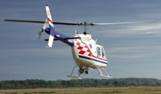
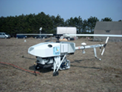
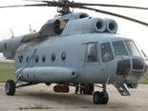
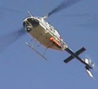
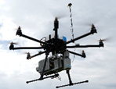
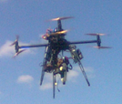
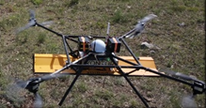
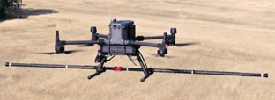
HV/HCR/HCR CTRO
2001 – 2004
1991 – 1996
2001 – 2003
2007 – 2008
2012 - 2015
2022 2023
3
Application of Aerial NTS in Croatia 2008 – 2009 in Bosnia & Herzegovina 2009 - 2011
Croatia | Area of Interest km² | Proposal for reduction km² | Reduced km²/% | Included km²
Gospić | 56,84 | 5,22 | 28/49,2 | 6
Bilje | 36,12 | 14,2 | 15,1/41,5 | 0
Sum | 92,96 | 19,5 | 43,1/46,2 | 6
B & H | Area of Interest km² | Proposal for reduction km² /% | Proposal to Include km²
Bihać | 16,3 | 4,8/29,4 | 1,15
Mostar | 16,5 | 10,4/63 | 2,7
Trebinje | 7,4 | 3,7/50 | 0
Sum | 40,2 | 18,9/47 | 3,85
YOLO – deep learning model for UXO detection in thermal video
Milan Bajić Jr.

Slide 4
Introduction
Thermal imaging/video
Explosive remnants of war (UXO, Landmines)
Object detection thermal imaging/video
Deep learning object detection (UXO)
YOLO – deep learning model for UXO detection in thermal video
Milan Bajić Jr.

Slide 5
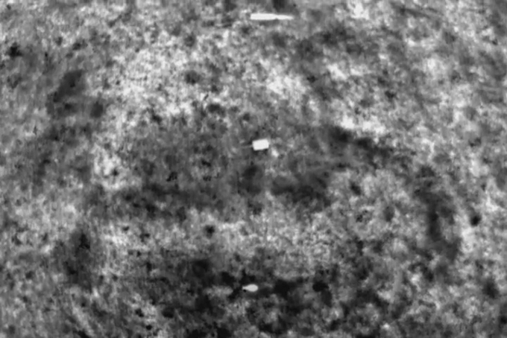
Evaluation Dataset UXOTi_NPA
NPA data collection
808 annotated images
1 to 3 objects per image
YOLO – deep learning model for UXO detection in thermal video
Milan Bajić Jr.

Slide 6
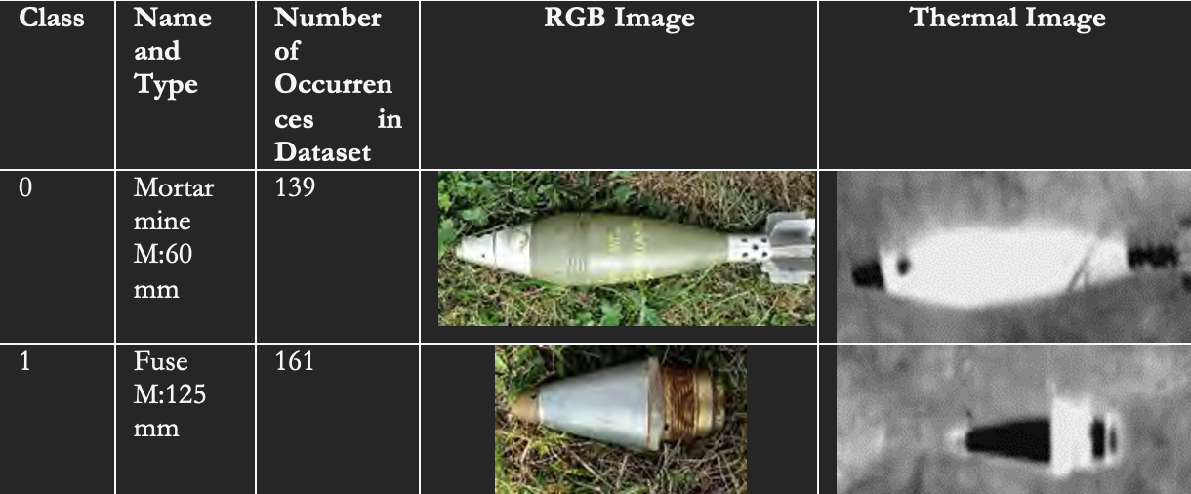
11 classes
79 to 161 occurrences/class in dataset
Training: 640 images; Validation: 80 images; and Testing: 88 images
YOLO – deep learning model for UXO detection in thermal video
Milan Bajić Jr.

Slide 7
YOLO Architectures
Comparison of five mainstream YOLOv5 and two YOLOv7 models, trained and evaluated on the COCO dataset
Model | mAP@0.5 | mAP@0.5:0.95 | Parameters (in Million)
YOLOv5n | 45.7% | 28.0% | 1.9
YOLOv5s | 56.8% | 37.4% | 7.2
YOLOv5m | 64.1% | 45.4% | 21.2
YOLOv5l | 67.3% | 49.0% | 46.5
YOLOv5x | 68.9% | 50.7% | 86.7
YOLOv7 tiny | 56.7% | N/A | 6.2
YOLOv7 | 69.7% | N/A | 36.9
YOLO – deep learning model for UXO detection in thermal video
Milan Bajić Jr.

Slide 8
EDGE computing devices
Raspberry Pi
NVIDIA Jetson
YOLO – deep learning model for UXO detection in thermal video
Milan Bajić Jr.

Slide 9
Experiment
5 models YOLOV5 (Bajić & Potočnik, 2023, ‘UAV Thermal Imaging for Unexploded Ordnance Detection by Using Deep Learning‘, Remote sensing, 15, 967.)
2 models YOLOv7 (Bajić jr., M.; Potočnik, B. UNEXPLODED ORDNANCE DETECTION ON UAV THERMAL IMAGES BY USING YOLOV7. In Proceedings of the ROSUS Univerza v Mariboru, Univerzitetna založba, March 16 2023. )
Google Colab Tesla T4 GPU
Detection time on video (inference)
YOLO – deep learning model for UXO detection in thermal video
Milan Bajić Jr.

Slide 10
Results – Inference time
Model | Model Size | Inference time (s)
YOLOv5n | 1,8 | 8,253
YOLOv5s | 7,1 | 8,345
YOLOv5m | 21,1 | 11,921
YOLOv5l | 46,4 | 19,074
YOLOv5xl | 86,6 | 36,863
YOLOv7tiny | 6,1 | 17,438
YOLOv7 | 36,8 | 22,730
YOLO – deep learning model for UXO detection in thermal video
Milan Bajić Jr.

Slide 11
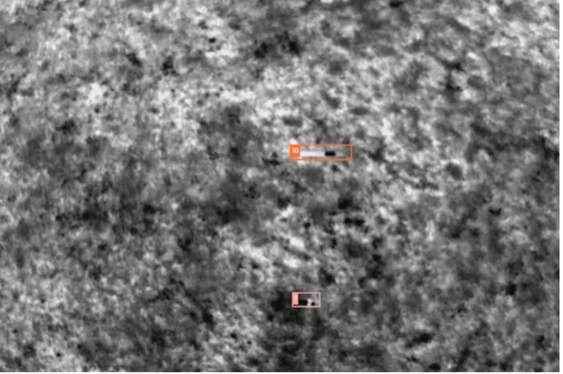
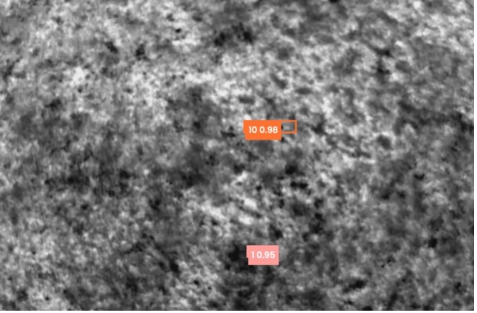
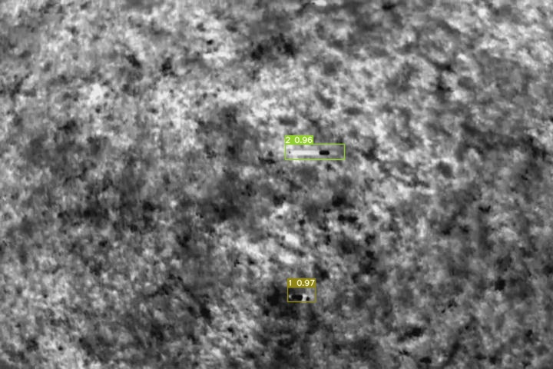
Eleven class detection - example
Annottated image
YOLOV5n detection
YOLOV7tiny detection
YOLO – deep learning model for UXO detection in thermal video
The class index and detection probability are written next to the bounding box.
Milan Bajić Jr.

Slide 12
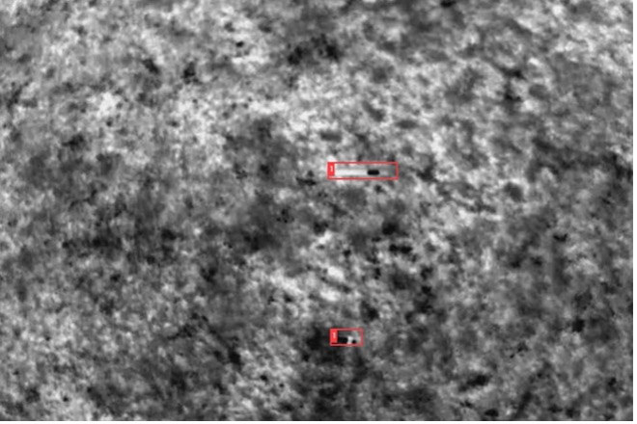
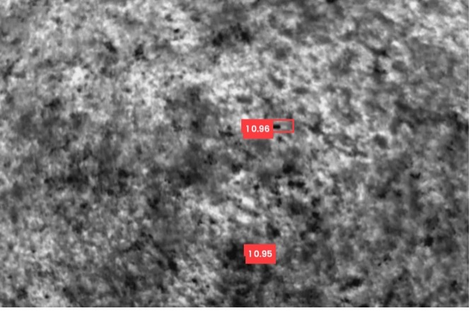
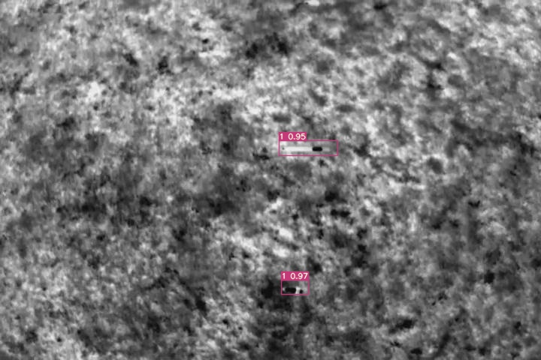
One class detection - example
Annottated image
YOLO – deep learning model for UXO detection in thermal video
YOLOV5n detection
YOLOV7tiny detection
The class index and detection probability are written next to the bounding box.
Milan Bajić Jr.

Slide 13
Eleven class detection video precision
Model | mAP@0.5 | mAP@0.5:0.95 | Parameters (in Million)
YOLOv5n | 99.5% | 87.0% | 1.9
YOLOv5s | 99.5% | 88.5% | 7.2
YOLOv5m | 99.5% | 89.9% | 21.2
YOLOv5l | 99.5% | 90.5% | 46.5
YOLOv5x | 99.5% | 89.7% | 86.7
YOLOv7 tiny | 99.5% | 86.8% | 6.2
YOLOv7 | 99.5% | 89.7% | 36.9
YOLO – deep learning model for UXO detection in thermal video
Milan Bajić Jr.

Slide 14
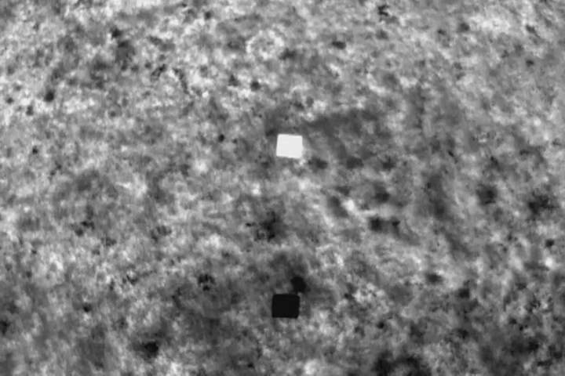
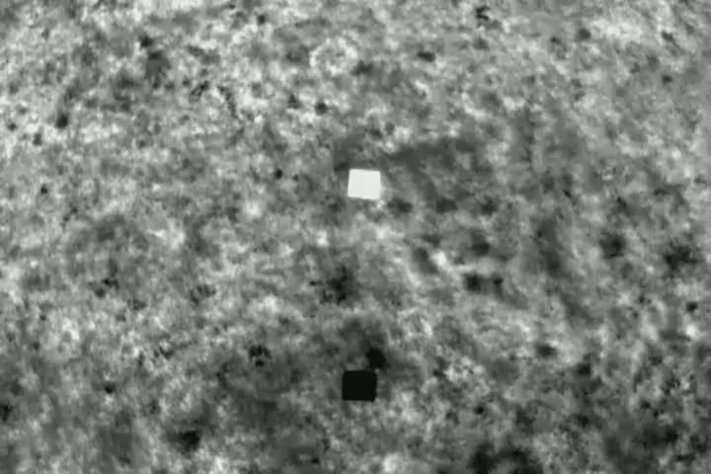
Eleven class detection video speed
8,253 sec
17,438 sec
YOLO – deep learning model for UXO detection in thermal video
Milan Bajić Jr.

Slide 15
OTHER SENSORS AND AI SOLUTIONS FOR FUTURE
GPR – positive AI results
HYPERSPECTRAL – waiting for AI in domain
MAGNETOMETER – waiting for AI
NLJD – waiting for reliable sensors and AI
VISUAL TRANSFOMERS
SEMI SUPERVISED SELF LEARNING
NON SUPERVISED SELF LEARNING
GAN NETWORKS FOR CREATING AUGMENTED DATA FOR TRAINING
YOLO – deep learning model for UXO detection in thermal video
Milan Bajić Jr.

Slide 16
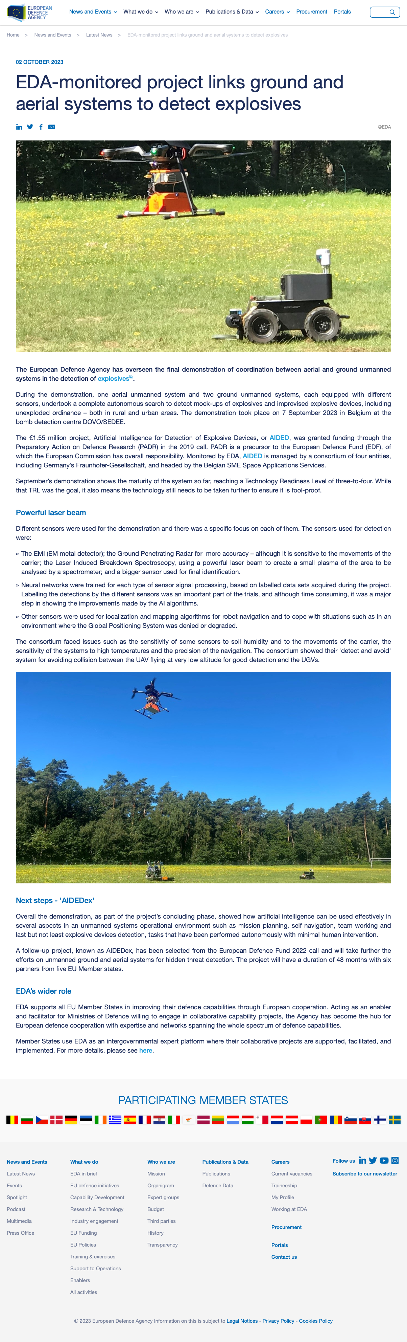
YOLO – deep learning model for UXO detection in thermal video
Milan Bajić Jr.

Slide 17
STARTED PROJECT ACTIVITIES THAT INVOLVE AI AND EO DETECTION
YOLO – deep learning model for UXO detection in thermal video
Milan Bajić Jr.

Slide 18
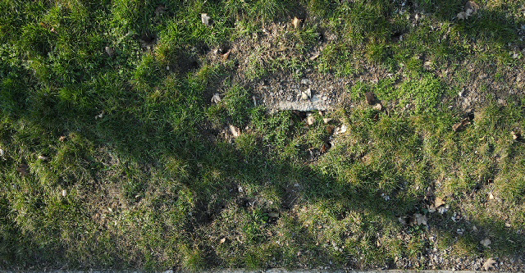
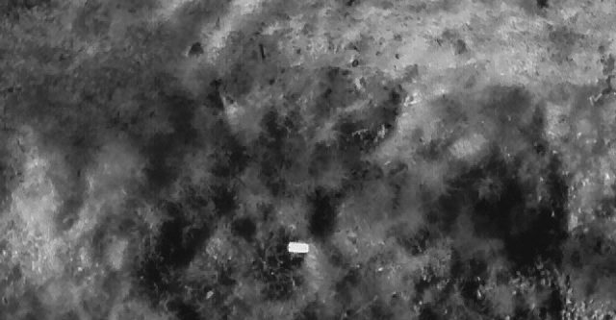
Discussion and conclusion
Solution for detection of objects of similar colour as background
Automated solution for large area survey
YOLOv5 superior to YOLOv7
Many more technologies and algorithms for research
Enhance funding and cooperation possibilities
YOLO – deep learning model for UXO detection in thermal video
Milan Bajić Jr.

Slide 19
Thank you for your attention, questions?
YOLO – deep learning model for UXO detection in thermal video
Milan Bajić Jr.

