Slide 1
U.S. Policy for Countering IEDs
Joint Program Office for Countering IEDs
Presented to
NATO EOD Demonstrations & Trials
October 11, 2023

Slide 2
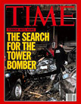
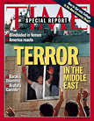
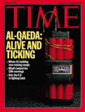
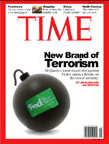
Bottom Line Up Front
1970
1970
1977
1983
1986
1989
1993
1995
1996
1996
2000
2002
2005
2010
2013
2015
IEDs are the “weapon of choice” and a significant and enduring global security challenge that requires the diverse capabilities of many departments and external stakeholders; the current threat environment adds an additional sense of urgency to counter-IED efforts
The U.S. has a whole-of-government policy and coordination framework to strategically counter the use of IEDs, via PPD-17 and the Joint Program Office for Countering IEDs (JPO C-IED)
Currently efforts are on-going to ensure PPD-17 is up-to-date and aligned with global threats
Notes:
2

Slide 3
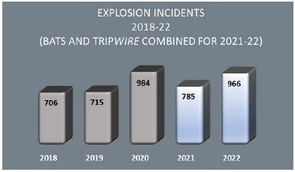
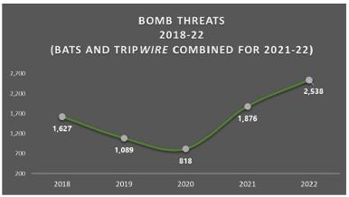
Domestic IED Threat Analysis – 2022 ​
The U.S. Bomb Data Center (USBDC) 2022 Explosives Incident Report encompasses information reported to the USBDC through the Bomb Arson Tracking System and Open-Source information collected through TRIPwire.
23% Explosion Incidents: the total number of explosion incidents increased by 23% from 785 in 2021 to 966 in 2022.
35% Bomb Threats: the total number of bomb threat incidents increased by 35% from 1,876 in 2021 to 2,538 in 2022

Slide 4
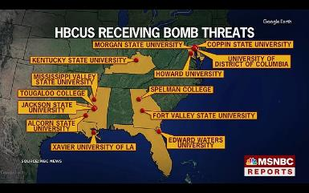
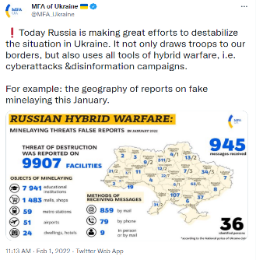
Trending Concern – Mass Bomb Threats
Bomb threats, include mass or serial attacks, are not new, but new technology and tactics makes their reach and impact far more scalable and disruptive
Prominent recent examples include Ivy League schools in November 2021 and Historically Black Colleges and Universities (HBCUs) in January and February 2022
Threats to thousands of Jewish community facilities in the U.S., UK, Australia, New Zealand, Denmark, and Norway occurred in 2017
In Ukraine, bomb threats are common in the context of Russian-backed information operations, but jumped to nearly 10,000 in January 2022, including nearly 8,000 schools

Slide 5
Current Strategic Counter-IED Challenges
Availability and Flow of Materials: Explosives and precursors are readily available, both internationally and within the United States.
Proliferation of Technical Knowledge: Operatives and returning foreign fighters spread knowledge, compounded by collapsing technology costs and use of Internet to motivate and instruct sympathizers to employ IEDs.
Sophisticated Concealment: As IED countermeasures advance, adversaries attempt to thwart them through clever bomb design, manufacture, placement, and masking. Recent examples include high-profile assassination and aviation plots.
Unmanned Delivery Systems: Terrorist groups have rapidly advanced the scale and sophistication of unmanned delivery systems. Remotely piloted ground vehicles and commercially available unmanned aircraft systems (UAS) are recent examples.
CBRN Enhancements: Terrorist groups continue to pursue the use of chemical, biological, nuclear, and radioactive devices. Chemical devices have been used recently in the ME.
Notes:
5

Slide 6
C-IED Mission Overview
Challenging mission with no “silver bullets”
Required capabilities cut across policy portfolios, intergovernmental authorities, and role of the private sector, general public, and international partners
Aims to prevent incidents “left of boom”, reduce consequences otherwise
C-IED capabilities are fundamental to, and draw upon:
Defense
Intelligence and information sharing
Counterterrorism
Law enforcement
Infrastructure protection, aviation security
Capabilities are technical, perishable, and can be resource-intensive due to enduring and evolving tactics
Success requires effective strategic planning, coordination, and prioritization due to needed resources, capabilities, stakeholders
Preparedness/resilience
Diplomacy
Dignitary and special event protection
Soft target security
C-WMD, C-UAS, and countermeasures RDT&E

Slide 7
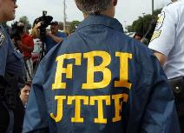
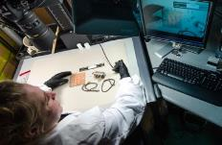
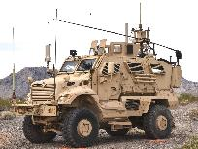
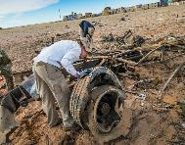
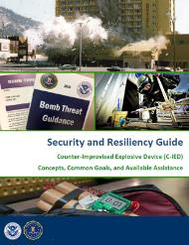
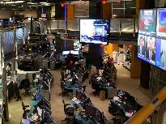
C-IED Mission Capabilities

Slide 8
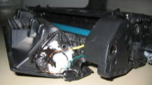
Evolution of C-IED Policy from 2005-Present
Historically, a patchwork of laws, policies, and guidance on IEDs existed within separate mission areas and disciplines of government, e.g., law enforcement, military, aviation security, consequence management, etc.
The 2005 bombings in London prompted the U.S. to develop more proactive, comprehensive domestic C-IED policy:
White House IED Task Force developed policy and predated JPO C-IED of today.
Homeland Security Presidential Directive 19 (HSPD-19) in 2007 emphasized a range of risk-management strategies and capabilities, from prevention though response.
The domestic focus largely divided civilian and military, domestic and international communities within U.S. Government.
New threats against global aviation beginning in 2009 prompted a policy review to integrate domestic and international efforts:
A series of significant transnational incidents occurred, including the attempted “underwear” bombing of Northwest Flight #253 in December 2009 and October 2010 air cargo “printer toner” plot.
Presidential Policy Directive 17, Countering IEDs (PPD-17) in 2012 emphasized integration between domestic and international, military and civilian activities and also formally mandated the JPO C-IED.
Notes:
8

Slide 9
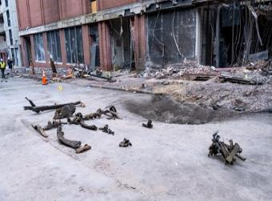
Why the Nashville Christmas Day Bombing Matters – Strategic Picture
Sophisticated device made from hundreds of pounds of easily accessible chemicals
Subject able to conceal construction of large IED and emplace in high-risk urban area
Subject was previously referred to law enforcement for potential bomb-making
“Near miss” of a 2nd Oklahoma City; adversary’s choices mitigated potential consequences
Blast caused cascading effects and demonstrated inter-relationship of physical-cyber consequences
Other cities and critical infrastructure still vulnerable to the highest-risk IED tactics, but also other threats could stress resilience
Notes:
Nashville encapsulates difficulties of securing explosive precursors, disrupting plots “left of boom”, responding to sophisticated IEDs, and protecting critical infrastructure
A robust counter-IED program is essential to national preparedness
State and local communities are on the front lines, but face challenges building and sustaining needed capabilities
Jurisdictions frequent report in the their annual FEMA risk assessments explosive devices are among the most challenging threats to their capabilities.
Critical Infrastructure Remains Vulnerable to the Highest-Risk IED Tactics
Gaps Persist in the Identification and Investigation of Bombing-related Incidents
Explosive Precursor Chemical (EPCs) and Bomb-making Materials Remain Readily Accessible
Vehicle-borne IED Defeat Challenges Persist
Post-blast Crisis Management Demonstrated Challenges for Public Messaging and Protective Measures

Slide 10
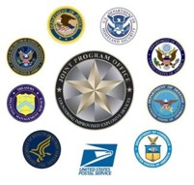
JPO C-IED Process
National Security Council (NSC)
Facilitates periodic Policy Coordination Committees (PCCs) or Interagency Policy Committees (IPC) to oversee policy implementation across U.S. Government
Consists of Assistant Secretary (or equivalent) members
Joint Program Office for Countering IEDs (JPO C-IED)
Directed in PPD-17 to support NSC
Facilitates a periodic Executive Committee meetings at the Deputy Assistant Secretary (or equivalent) level to oversee progress
Facilitates a bi-monthly Implementation Committee at the program manager level to coordinate progress within the Working Groups
JPO C-IED Working Groups
Task-based groups that coordinate implementation and address challenges at the working level
Consists of program managers and experts from throughout U.S. Government
Currently task-organized around the four C-IED strategic goals outlines in the PPD-17 IPlan
Notes:
10

Slide 11
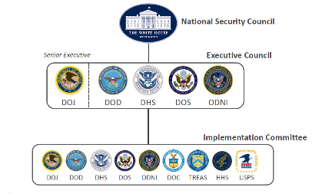
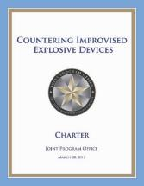
The JPO C-IED Role and Structure
Support the National Security Council to implement U.S. counter-IED policy
Facilitate the integration and alignment of domestic, transborder, and international activities across the United States Government necessary to counter IEDs in accordance with national policy; and
Coordinate, track, and, as necessary, escalate implementation issues relating to the execution of specific tasks to counter the use of IEDs.
The JPO C-IED is effectively a standing sub-IPC/PCC to the Restricted C-IED PCC/IPC used since the George W. Bush Administration.

Slide 12
Key Themes of PPD-17
Enhance ability to deter, detect, and prevent IEDs before threats become imminent.
Need to “discover IED threats” as early as possible - known as getting ‘left-of-boom’ within the counterterrorism community
Examples include numerous IED plots that have been disrupted in the U.S. since 9/11, including numerous DVE plots in 2020
Ensure that protection and response efforts effectively neutralize or mitigate the consequences of attacks that do occur.
Examples include the rapid, intergovernmental and whole community crisis response to the Boston Marathon, Austin, VIP mail, and Nashville bombings.
Enhance the effectiveness of counter-IED efforts in specific ways, including:
Leveraging and integrating a “whole-of-government” approach across law enforcement, diplomatic, homeland security, and military disciplines;
Enhancing efforts to protect American lives at home and abroad; and
Promoting and enhancing information sharing and cooperation between all levels of government, international partners, and the private sector.
Notes:
12

Slide 13
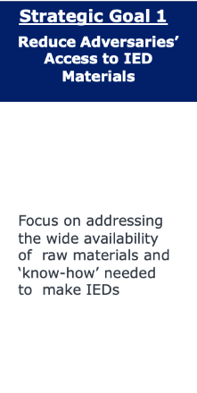
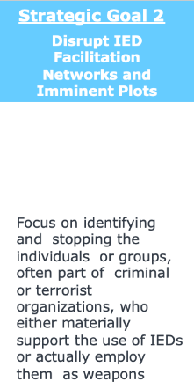
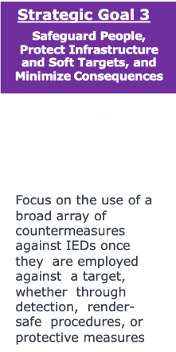
Goals of Updated C-IED Implementation Plan
The Implementation Plan (IPlan) is the roadmap of strategic goals and objectives necessary to achieve U.S. C-IED policy, guiding U.S. Government implementation activities and informing domestic and international stakeholders.
Leads: DOJ, DHS
Objectives: 3
Leads: DOJ, DHS
Objectives: 4
Leads: DOJ, ODNI
Objectives: 5
Leads: DOJ, DHS
Objectives: 3
Notes:
13

Slide 14
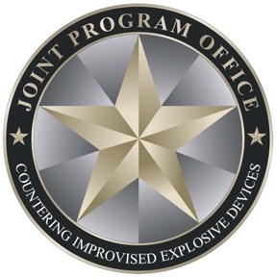
Joint Program Office for Countering IEDs
Federal Bureau of Investigation
U.S. Department of Justice
jpo@fbi.gov
Michael D. Holt
Chief of Staff, Supervisory SABT
mdholt@fbi.gov
Jason S. Stewart
Deputy Strategy Branch Chief, DHS OBP
Jason.stewart@cisa.dhs.gov

